Slide 1



Slide 2
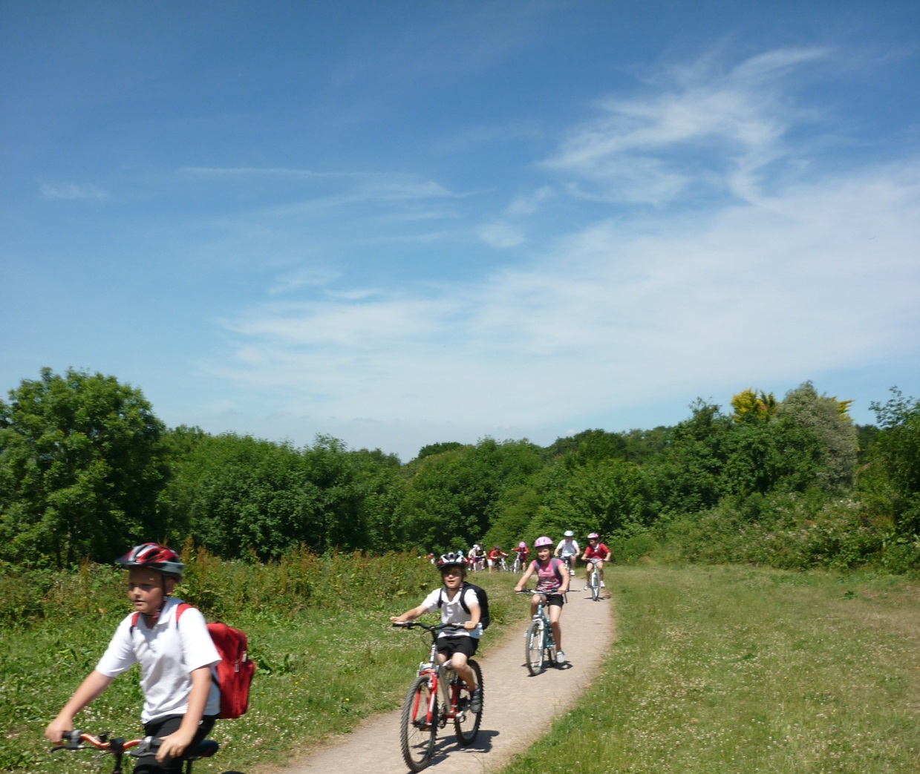
Welsh Baccalaureate
Global Citizenship Challenge KS4
Living Sustainably
Teaching and Learning Resources

Slide 3
Session One
You will:
develop a detailed understanding of the global issue
analyse issues using PESTLE
explore how to effectively solve problems and make decisions.

Slide 4
How did you travel to school today?
Click on the link to the video below and compare your journey
http://bit.ly/1g5VkBZ
“Children from a remote village in southern China face a treacherous journey home from school, up 230-foot ladders that stand against a vertical cliff. The children, who go to school 30 miles away from their remote village in Sangzhi County, Hunan Province rarely have the opportunity to go home. When they do have the chance to visit their parents, they must first navigate a rocky mountain path, before climbing 65 feet up rickety wooden ladders to reach their destination.”

Slide 5
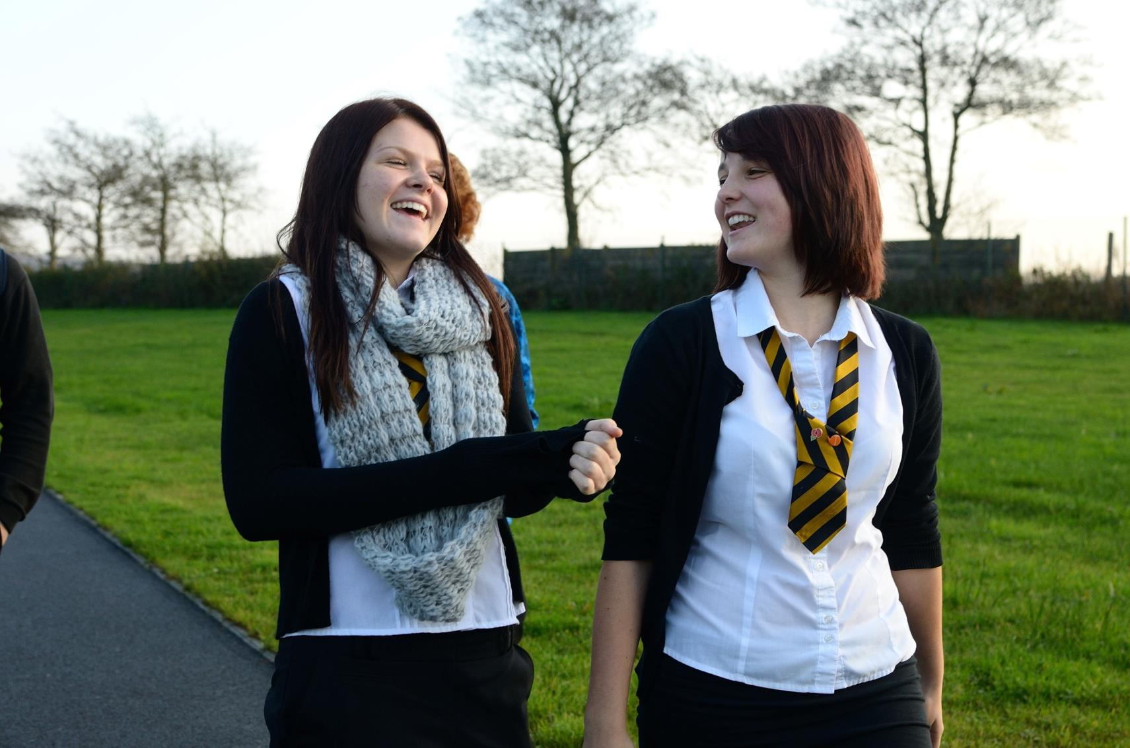
Global Citizenship
How does the way I travel relate to global citizenship?

Slide 6
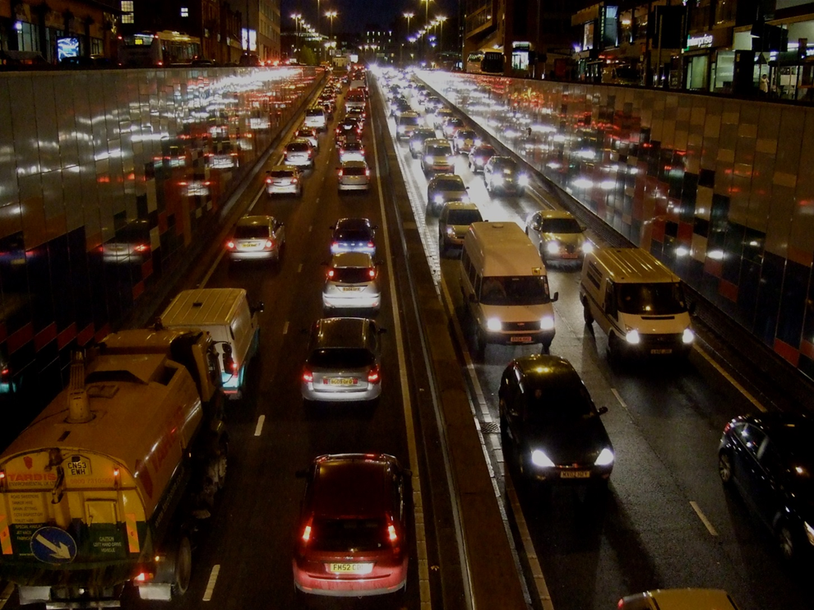
Why might dependency on cars be a problem?
Why could this be a problem?

Slide 7
PESTLE: a way to analyse an issue.
POLITICAL
ECONOMIC
SOCIAL
TECHNOLOGICAL
LEGAL
ENVIRONMENTAL

Slide 8
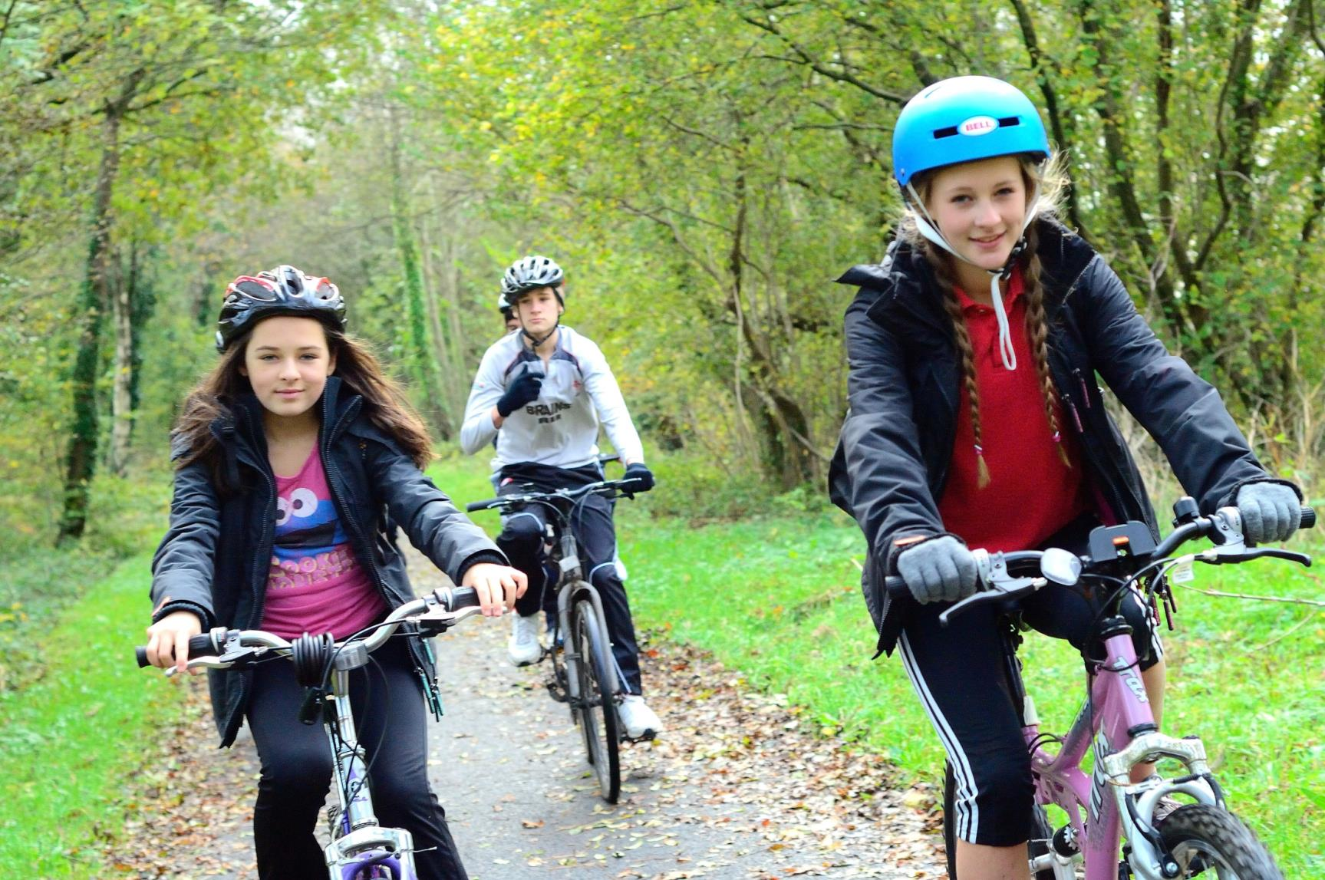
How else can we travel?

Slide 9
Transport in San Francisco
Click on the link to the video or use the text in Activity 3
https://www.youtube.com/watch?v=zAc2vWdcmGk

Slide 10
SWOT Analysis
Activity Three in your Activity Pack.
Each group considers a transport plan from around the world and completes a SWOT analysis of the solution described, using the SWOT frame.
Consideration point: how well do you think this plan would work in your local area?

Slide 11
Session Two
You will:
consider of a variety of sources and viewpoints
critically assess a variety of sources.

Slide 12



Interpreting Sources
“You can use all the quantitative data you can get, but you still have to distrust it and use your own intelligence and judgement.”
Alvin Toffler, US Futurist
What questions do we ask about sources of data?

Slide 13
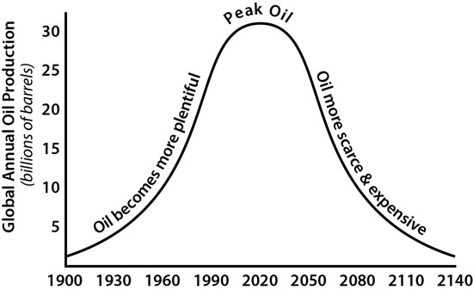
1. What does this diagram suggest?
2. What questions would you ask about it?
Source: www.explainingthefuture.com
Notes:
Teacher Notes:
Question 1: The diagram suggests that oil reaches a peak of production around 2020 and then becomes rarer and more expensive.
Question 2: Encourage your students to consider who? when? where? what? how? why?
Who produced this graph? [Would they trust it more if an oil company or a university had produced it?]
When was it created? [Ask them which do they think would be more credible: a graph created in 1930 or one created in 2015.]
Where is it from? [Why might this be on the website of an oil company? What about if it was on the website of a company making electric cars?]
What data would have been used to create the graph? [Ask students if it is possible to have data from 2140.]
How accurate is it? [Ask students to look at the scale.]
Why might this have been published? [Having considered all the questions above, why do the class think it could have been published.]
Information about the graph: this graph is an annotated version of a graph produced in 1956 by M. King Hubbard, a geoscientist who worked at the Shell research lab in Texas. This graph illustrates his prediction that petroleum extraction would reach a maximum rate, after which the rate of production would enter terminal decline. He created this prediction model for Shell, to guide their planning for the future.
The prediction is controversial, with some opponents pointing to potential new sources of oil and new extraction technologies that have not yet been discovered. Others have suggested that climate change will be more of a limiting factor and will mean that a decision will be taken to leave oil in the ground because to use it as a fuel will pose an unacceptable threat. You might want to ask the class what further information they would like to assess this data.

Slide 14
Critical Literacy
Activity Four contains two articles about sustainable transport solutions. Complete the table to analyse these articles.
When you’ve completed the table, decide:
which article shows greater bias and how
which article you think is more reliable and why.

Slide 15
Session Three
You will:
consider of a variety of sources and viewpoints
consider how you form a personal standpoint.

Slide 16
Lines of Opinion
If you are able to walk or cycle it is selfish to travel by car for short journeys of under a mile.
Our transport system is bad for us; it has to change.

Slide 17





Stakeholders
People have different opinions:
Activity Five is about considering different viewpoints about an issue.

Slide 18
Different Viewpoints
For me it’s simple, fewer cars lead to fewer accidents.
We have promised to reduce carbon emissions by 2020.
Animals and plants are endangered as a result to a changing climate made worse by our actions.
Driving the car has always been the most convenient option.
Traffic congestion has a negative effect on business.
Quality of life is improved when air and sound pollution are lower.
Walking and cycling are great for a healthier lifestyle.
The road infrastructure was built for cars.

Slide 19
Session Four
You will:
evaluate creative and innovative solutions
develop critical thinking and problem solving.

Slide 20
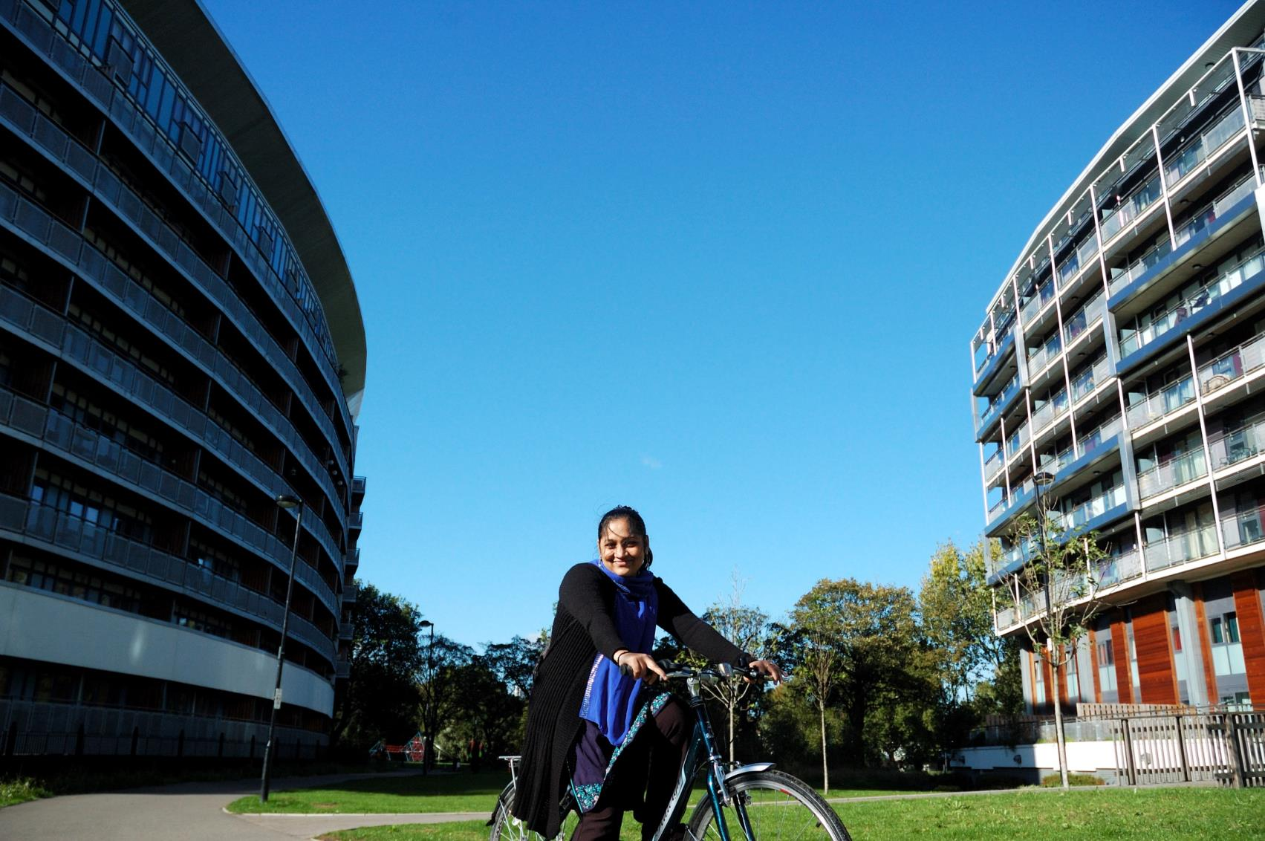
Mini-challenge
It is the year 2045.
How will we travel?

Slide 21
Session Five
You will:
reflect about how you think critically and solve problems
develop your personal standpoint
reflect about how you effectively develop opinions.

Slide 22
Reflecting on your Personal Standpoint
To develop your standpoint you have:
brainstormed ideas
completed a SWOT analysis
analysed the suggestion using PESTLE
summarised key elements (Elevator Pitch)
considered different viewpoints
considered a range of sources.

Slide 23
Session Six
In this session you will:
generate appropriate and realistic ideas for creating awareness
produce appropriate raising awareness outcomes
use a logic framework as a project planning tool.

Slide 24

Logic Framework
1 | 5 | 4 | 3 | 2
Problem | What will we need? | What will we do to raise awareness? | How do we know it’s achieved? (Outcome) | Solution
Litter in Year 9 Area |  |  |  | Year 9 use bins

