Slide 1
[SCHOOL NAME]
joins Bike to School Week 2021
Notes:
Welcome slide adapted for individual schools.

Slide 2
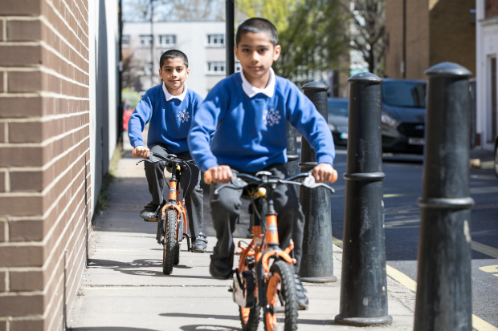
What is it?
Bike to School Week is a week-long event taking place on the 27 September – 1 October 2021.
Schools celebrate cycling and scooting and the positive impact it has on health and wellbeing.
©2021, Kois Miah, all rights reserved

Slide 3
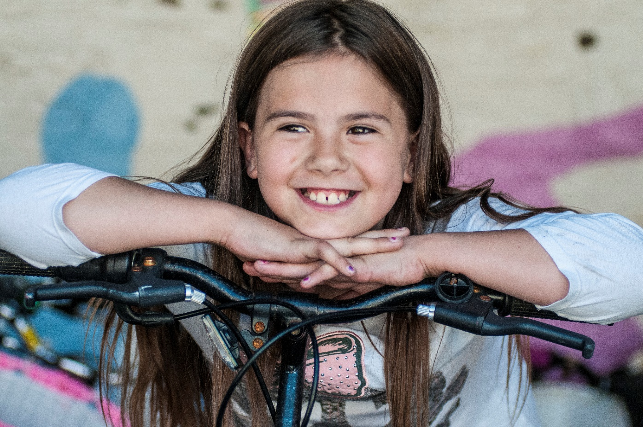
How can I cycle or scoot to school?
©2015, Sustrans
Notes:
Encourage pupils to think if they could cycle or scoot to school during Bike to School Week

Slide 4
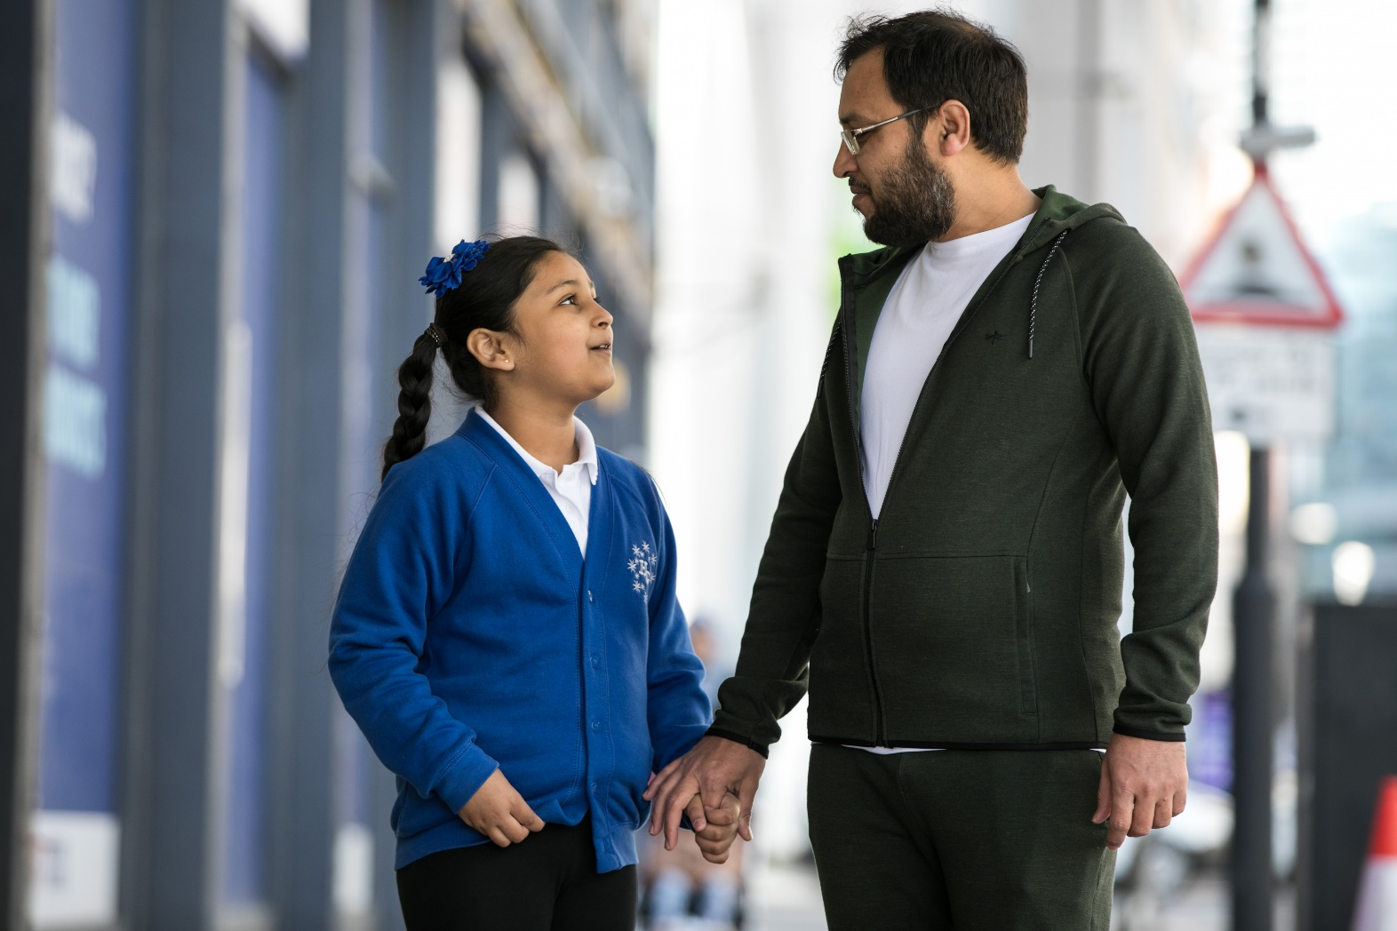
Ask a parent or guardian
©2021, Kois Miah, all rights reserved
Notes:
Encourage pupils to tell their parents or guardians about Bike to School Week so they can plan to travel actively to school.

Slide 5
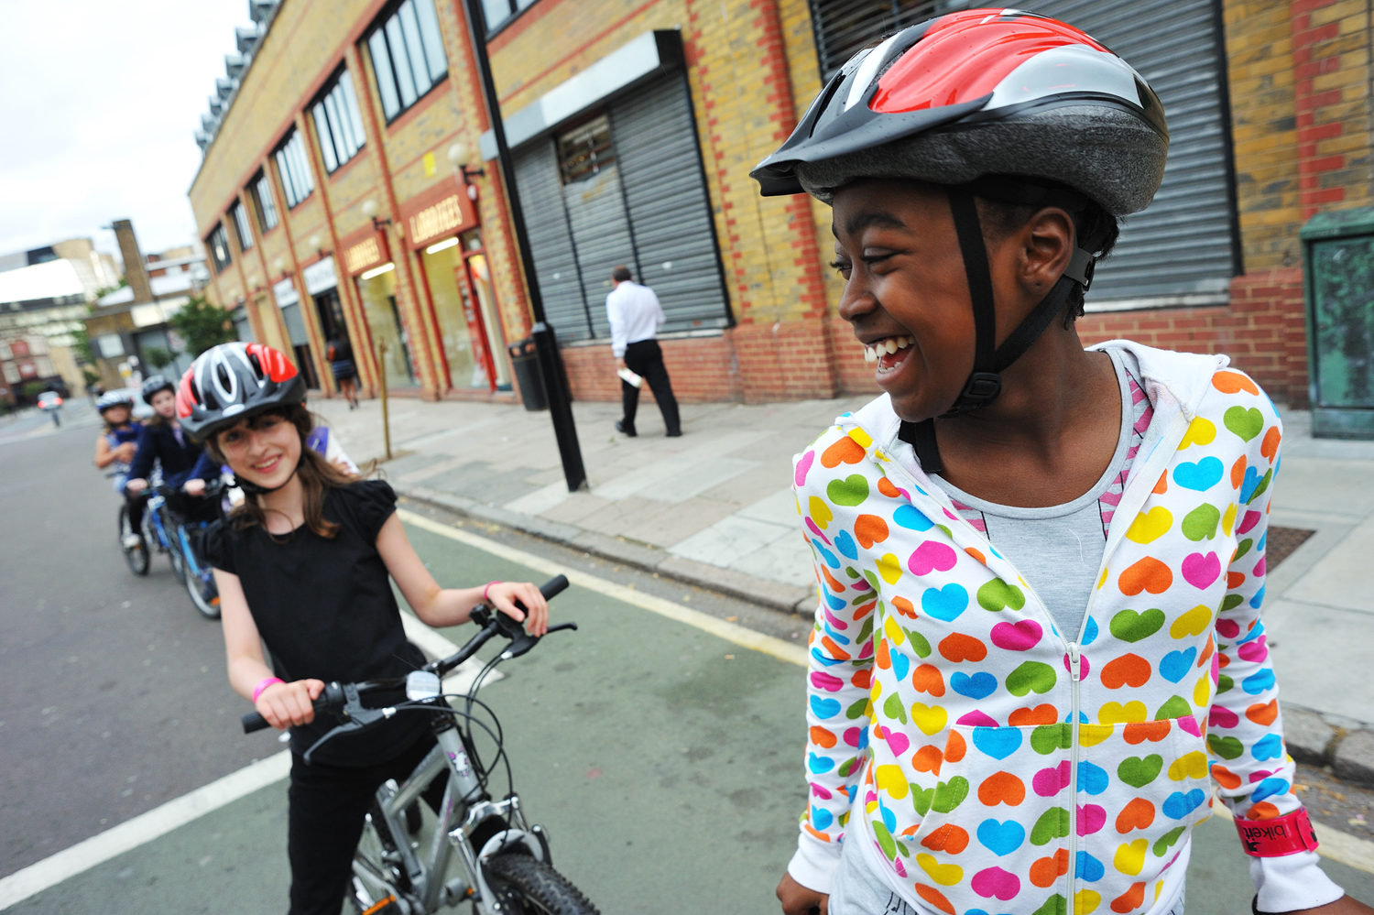
Put on your helmet
© J Bewley/Sustrans
Notes:
Inform pupils of the importance of wearing a helmet when riding a bike

Slide 6
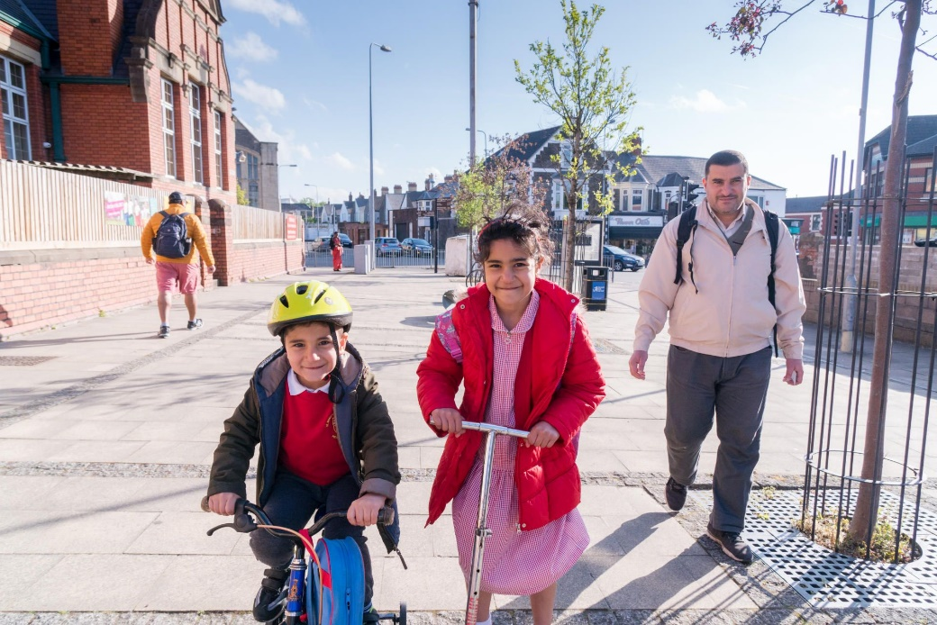
Choose a safe route
© 2017, Jonathan Bewley
Notes:
Encourage pupils to take a route to school which is safe. This could mean they choose a route which has less traffic or has cycle lanes.

Slide 7
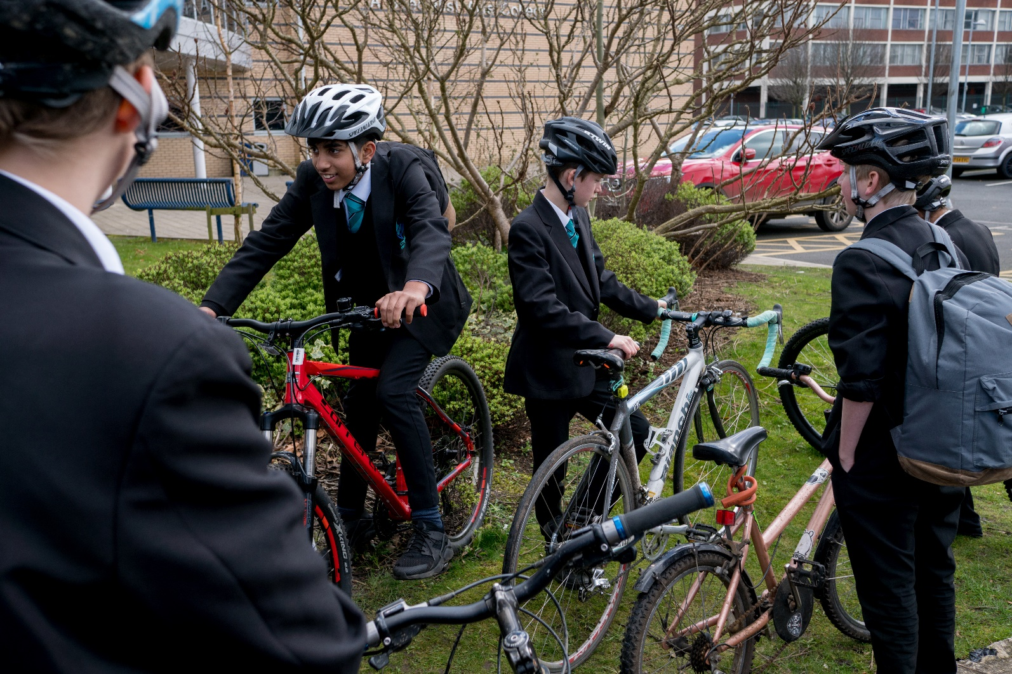
Meet up with friends
©2017, Jonathan Bewley, all rights reserved
Notes:
Encourage pupils to get their friends to take part in Bike to School Week as well. They can either meet on the way to school or once they arrive.

Slide 8
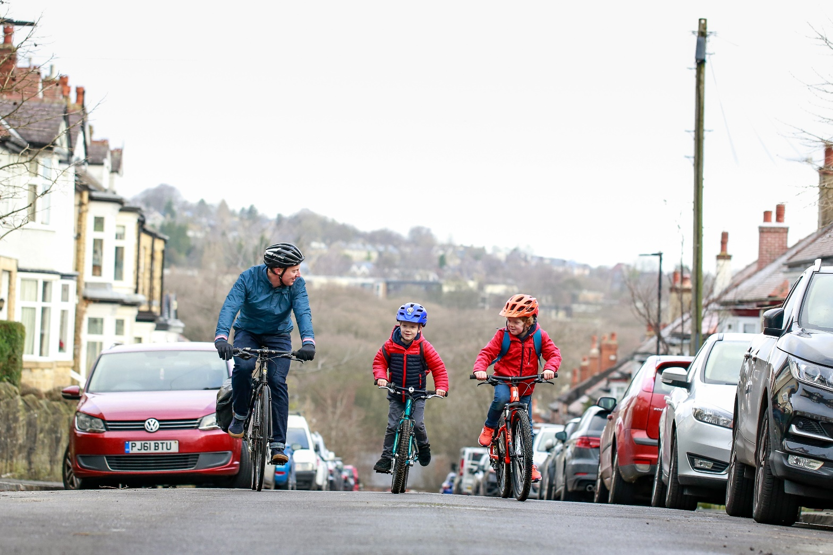
Encourage your family to join
©2020, Chris Foster, all rights reserved
Notes:
Parents and guardians are welcome to join in to. Make sure you send them the poster and e-flyer to encourage families to take part in Bike to School Week

Slide 9
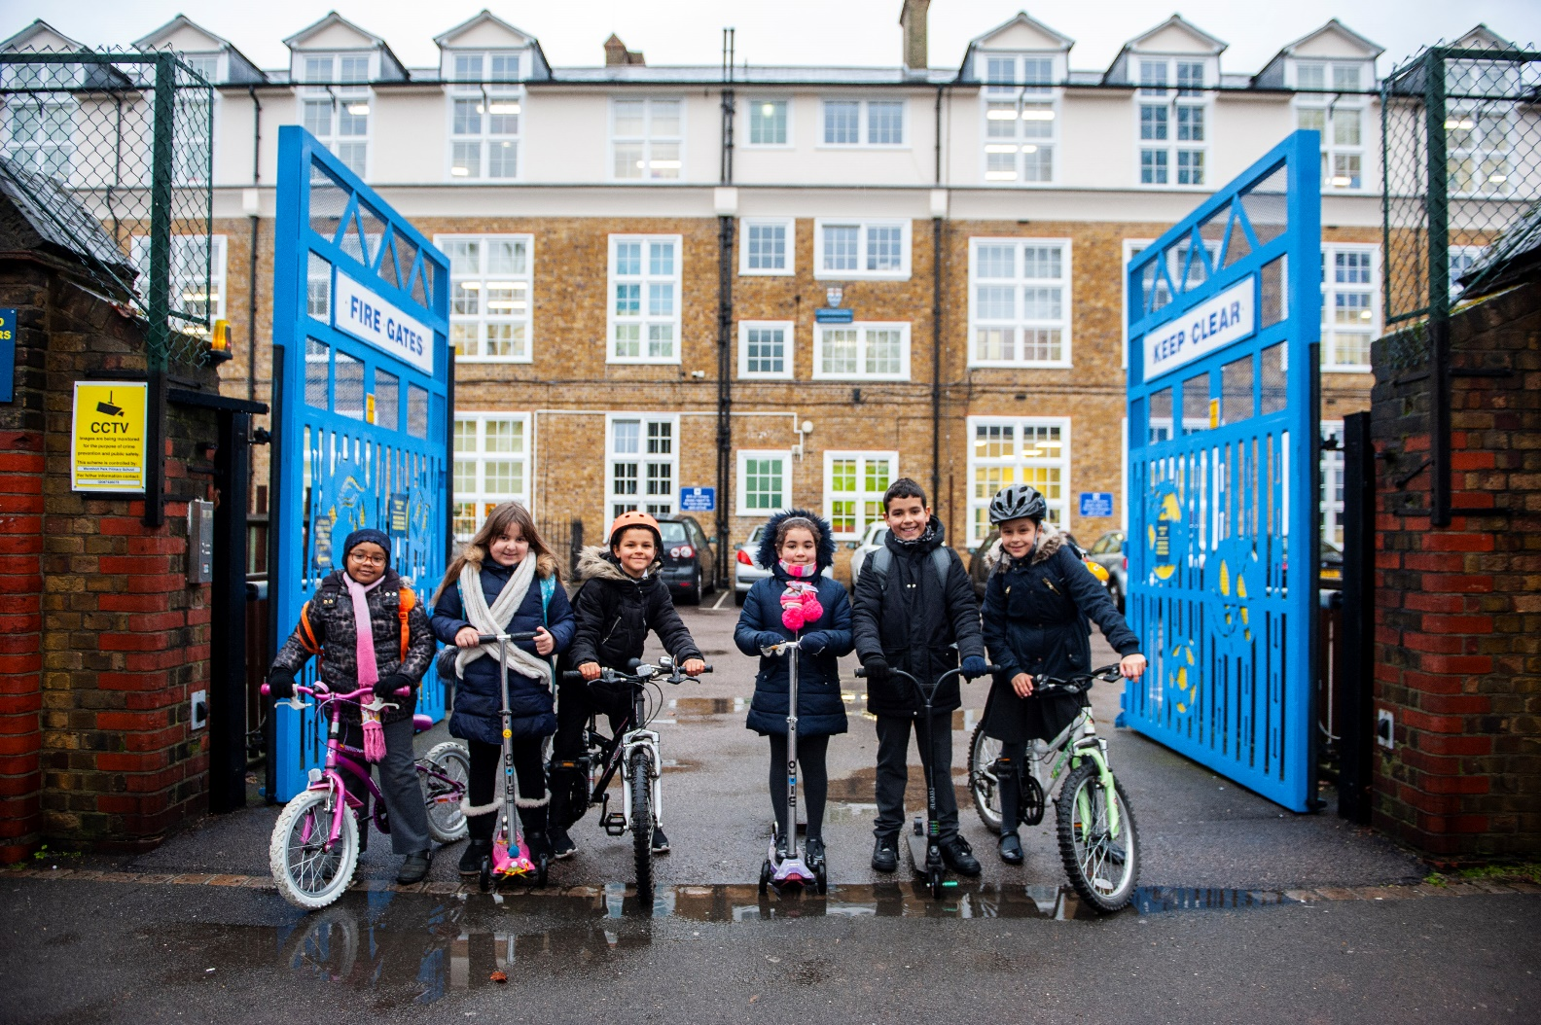
Not sure on something? Ask a teacher
©2019, Paul Tanner, all rights reserved
Notes:
Use the Inclusivity Guide to help children and families with barriers to participation

Slide 10
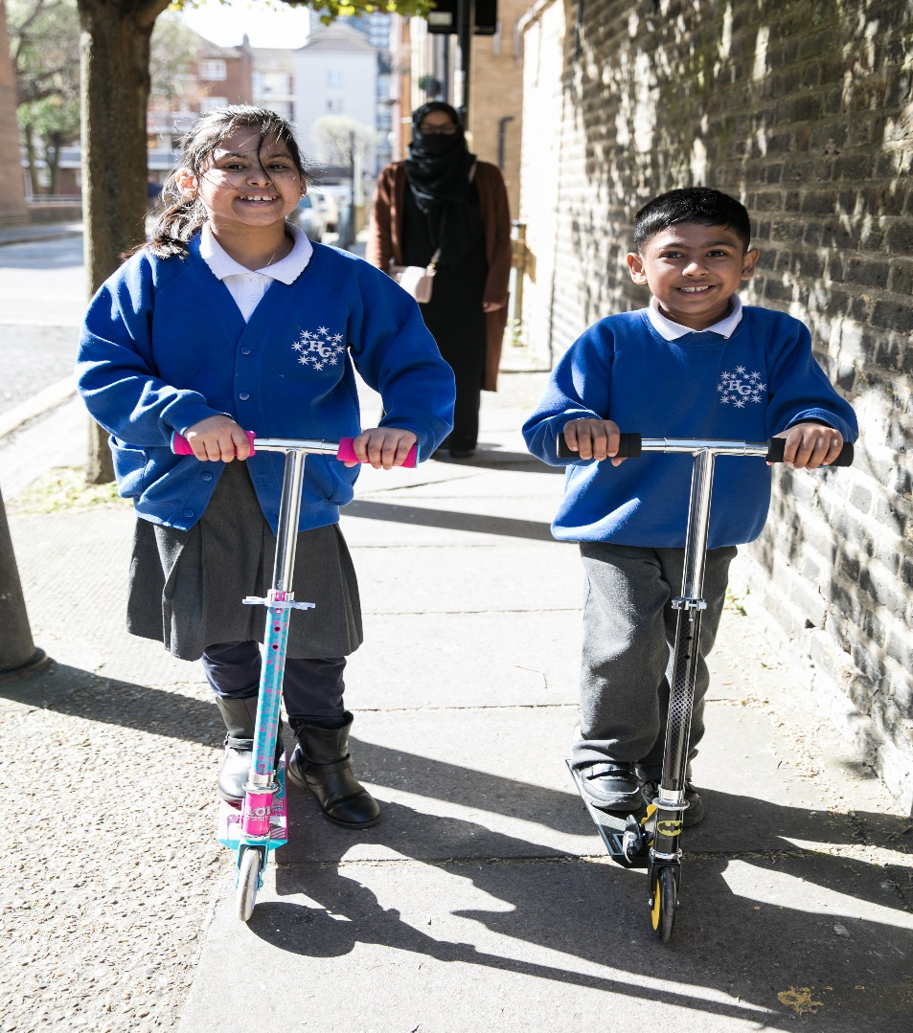
Enjoy the ride!
©2021, Kois Miah, all rights reserved

Slide 11
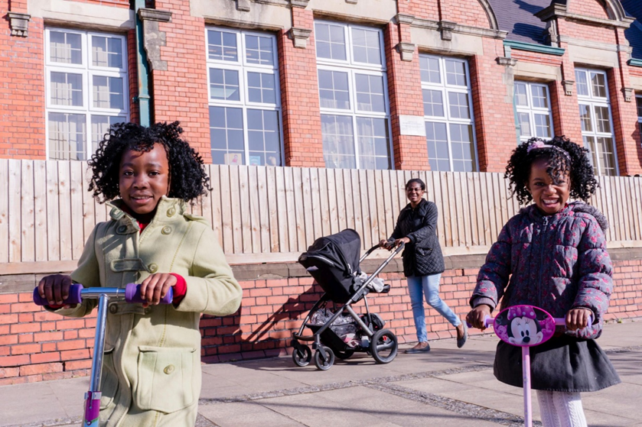

Good luck!

