Slide 1
[SCHOOL NAME]
joins Bike to School Week 2021
Notes:
Welcome slide adapted for individual schools.

Slide 2
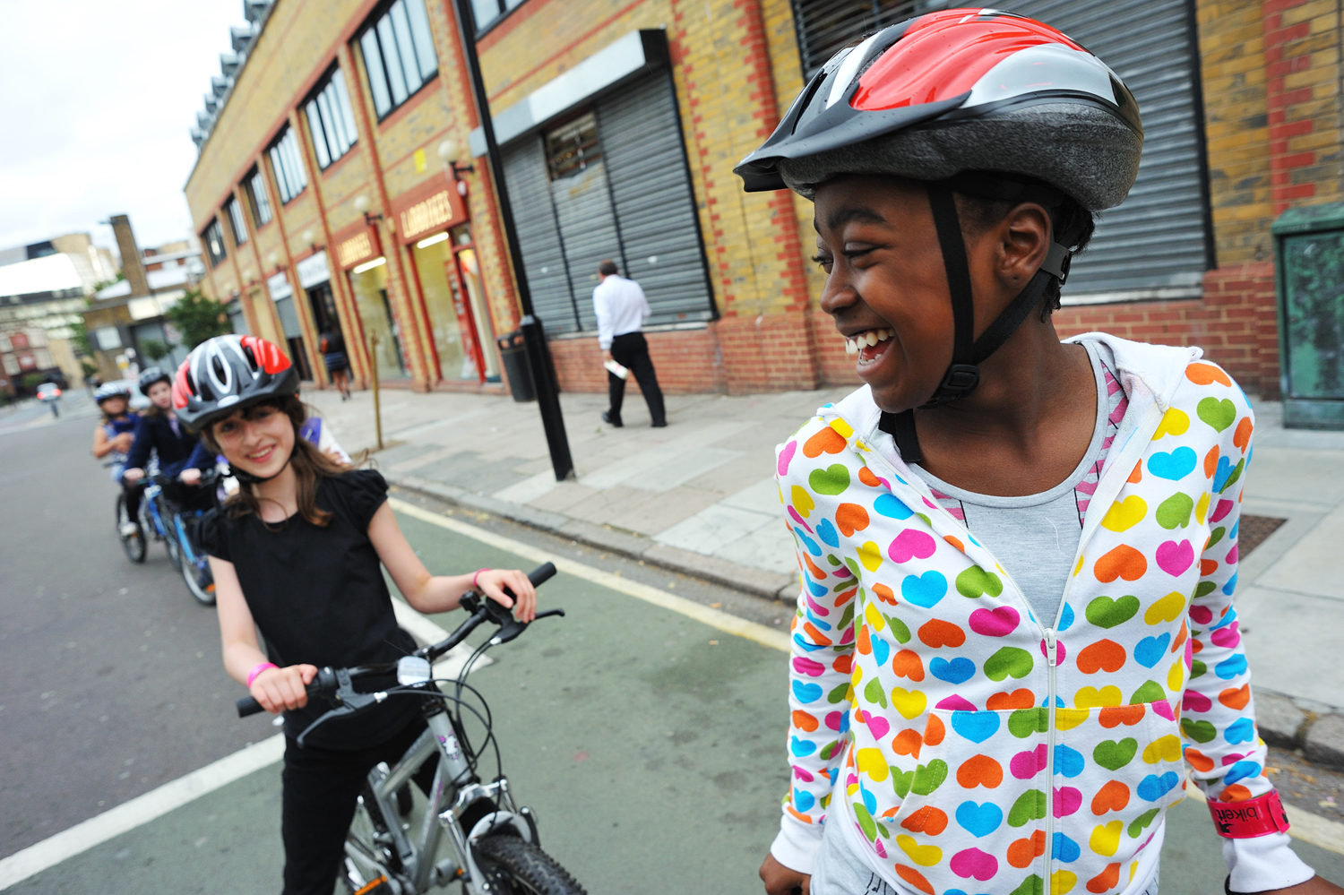
What is it?
Bike to School Week is a week-long event taking place on the 27 September – 1 October 2021.
© J Bewley/Sustrans
Participating schools encourage families to cycle or scoot to school. It’s a great opportunity to celebrate cycling and scooting and the positive impact it has on children’s health and wellbeing.

Slide 3
Why take part?
Active travel is more important than ever to help pupils get to school safely and healthily. The start of term is a great time to establish positive travel habits early.
Cycling to school has many benefits including:
pupils who are more relaxed, alert and ready to start the day
fewer cars helping to improve local air quality and reduce congestion
children who are more aware of road safety and who feel more independent
a boost to physical and mental health and wellbeing

Slide 4
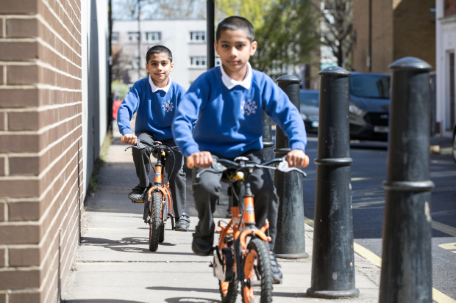
Getting ready
Show our Junior doctor bike resource, M check video and L check video in class
Use the assembly presentation to introduce Bike to School Week to your school
- Visit: www.sustrans.org.uk/biketoschoolweek to view the resources and find out more
©2021, Kois Miah, all rights reserved

Slide 5
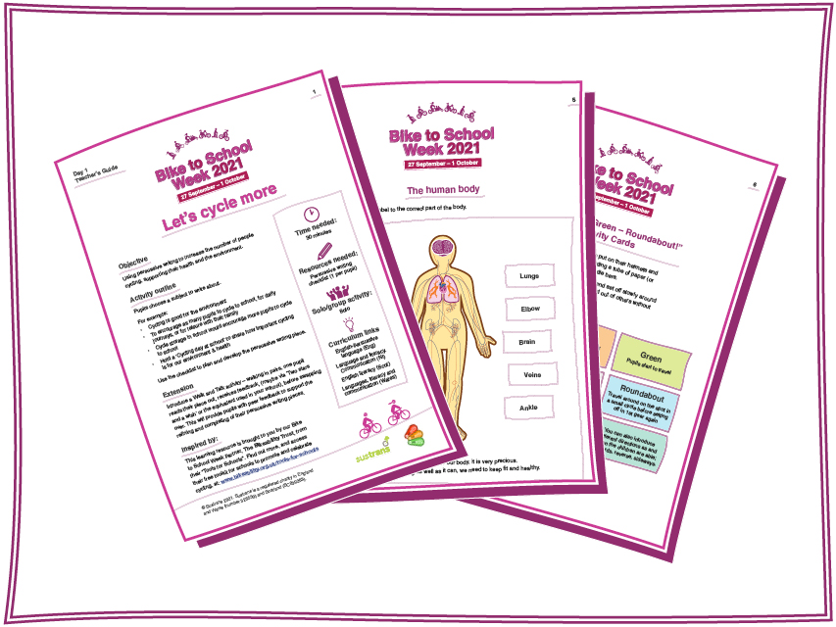
Classroom activities
Familiarise yourself with our free curriculum based activities- five for each key stage (EYFS, KS1, KS2 and KS3)
Visit: www.sustrans.org.uk/biketoschoolweek to view the resources and find out more

Slide 6

Spread the word
Tell parents and guardians you’re taking part in parent newsletters, on your intranet or in any other way you communicate to this group.
Send them the link to our M-check and L- check video to get their bikes and scooters ready (https://www.youtube.com/watch?v=4qtx60bcNk0) and (https://www.youtube.com/watch?v=hwQL_iorrAg)
Use the poster and e-flyer to let parents know about the ‘We’re taking part’ pledge with a chance to win a family prize.
Invite parents to download Sustrans’ free guide to walking, cycling and scooting to school at www.sustrans.org.uk/family-school-guide. The e-flyer can be used to do this
Find out more about the pledge at the Sustrans website: www.sustrans.org.uk/biketoschoolweek/pledge

Slide 7

‘We’re taking part’ pledge
During Sustrans Big Pedal 2021 over half a million children cycled or scooted to school.
We’d like to know how many families cycle or scoot to school during Bike To School Week 2021. That’s why we are asking families to tell us their child is taking part.
How parents and guardians can tell us they are taking part;
In the run up to, or during Bike to School Week they visit www.sustrans.org.uk/biketoschoolweek/pledge
They tell us how many days they plan to cycle or scoot to school during Bike To School Week.
Everyone that tells us they are taking part will automatically be entered into a free prize draw to win a Frog bike.

Slide 8
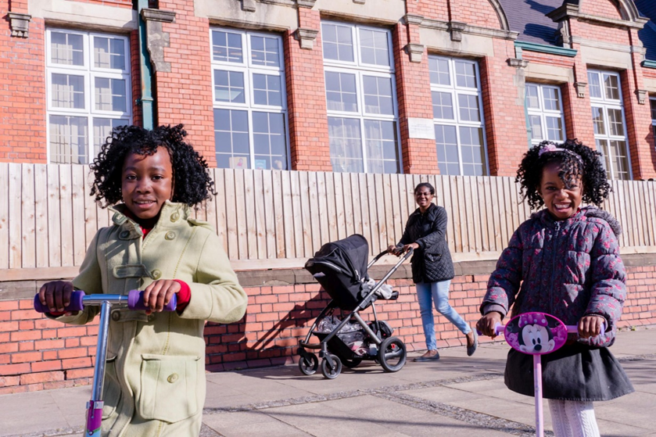

During Bike to School Week
Encourage pupils, parents and staff to cycle or scoot to school
Use the Bike to School Week classroom activities as a short activity or as a classroom starter
Take part in the daily Kahoot quizzes: www.sustrans.org.uk/biketoschoolweek

Slide 9
Shout about it
It’s great to see so many pupils taking part in #BikeToSchoolWeek this morning. Active travel gives pupils a healthy start to the day, boosts their mood and helps to make the school gates a safer place to be.
Use the hashtag #BikeToSchoolWeek to share any activities you complete during the week. We’ve pulled together some suggested tweets for inspiration:
#BikeToSchoolWeek by @Sustrans & @Bikeability is back! From 27 September to 2 October we’re asking pupils to #cycle or #scoot to school and feel the amazing benefits of active travel.
We’re super excited to be taking part in #BikeToSchoolWeek between 27 September and 1 October. #Cycling and #scooting to school has a real positive impact on the health and wellbeing of pupils.

Slide 10
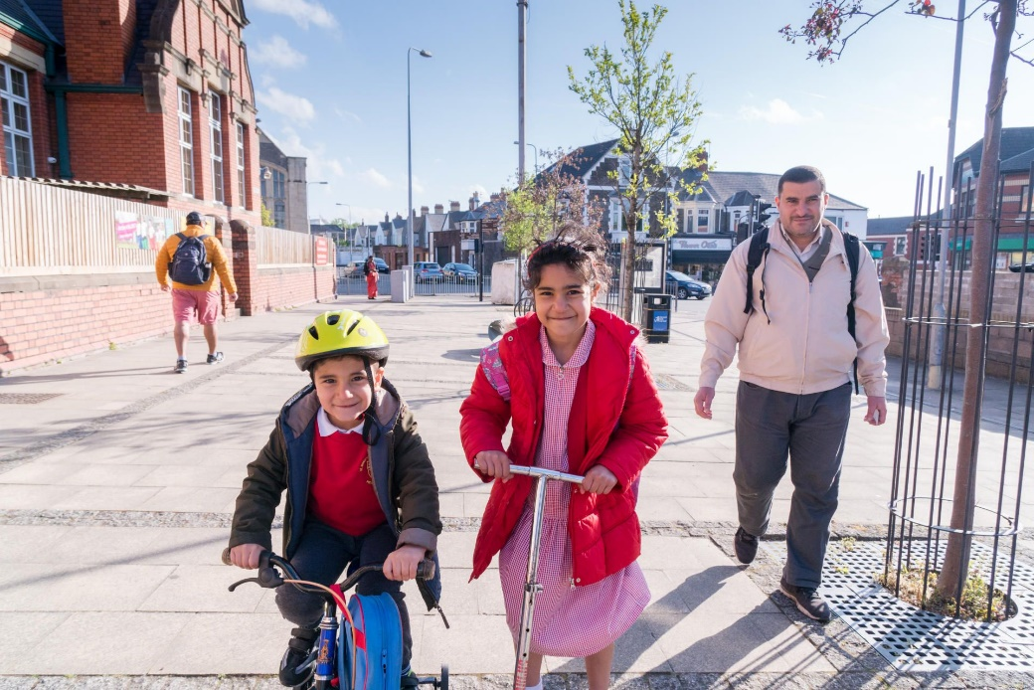
Good luck!
© 2017, Jonathan Bewley

