Slide 1
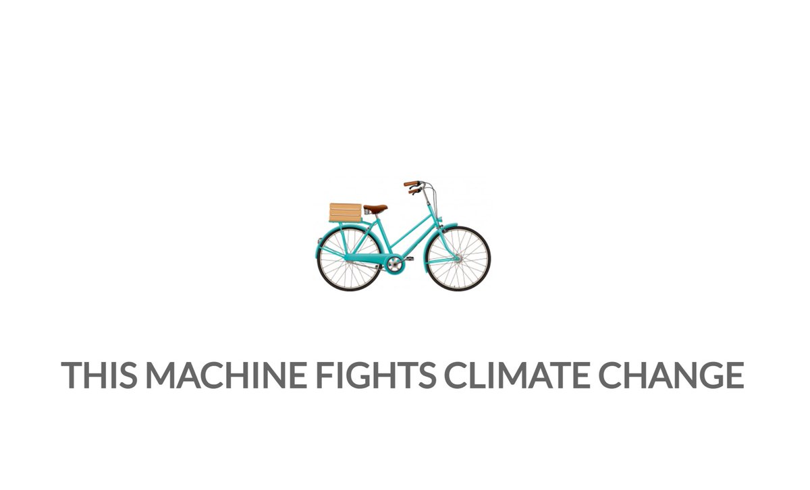

How does Cycling fight Climate Change?

Slide 2
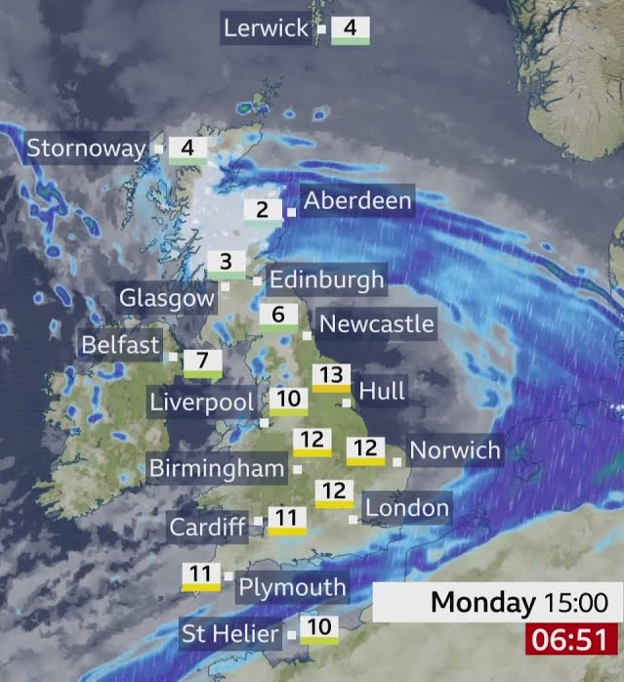
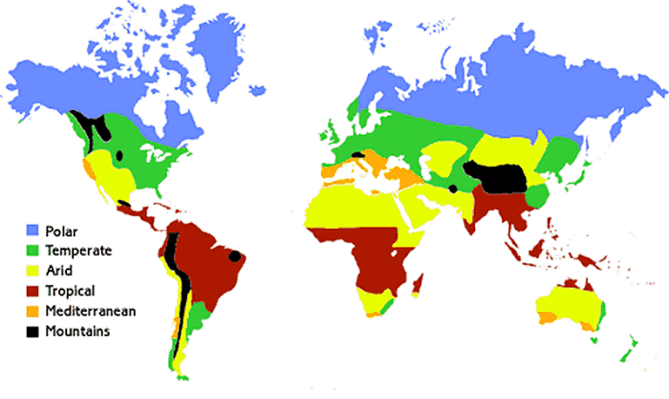
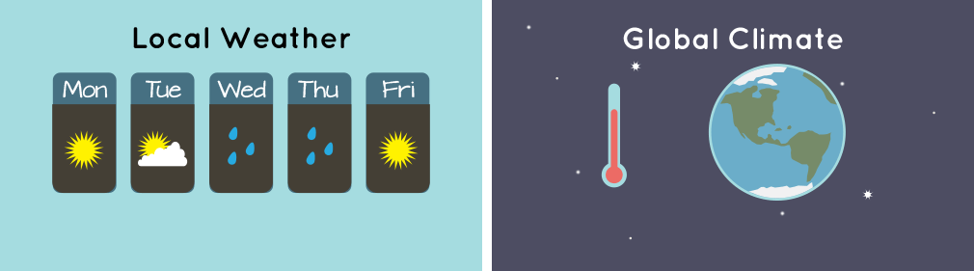
What’s the difference between Weather and Climate?
Notes:
Q: What's the difference between weather and climate?
Weather is day to day changes that happen locally. For example, the weather today is ____________, but tomorrow could be completely different.
However, overall the climate here is still temperate, as we don’t experience very much extreme weather and there are clear seasonal patterns.
Climate describes average weather conditions over a long period of time (30 years) and over large areas.
The climate is determined by many different factors, including distance from the equator, elevation, distance from the sea, and vegetation.
The world has five main climate zones.
Polar: Cold and dry with long and dark winters, and short summers. Temperatures don’t rise above freezing very much,
Temperate: Have four seasons, with warm summers and cool winters.
Arid: Hot and dry all year round. They get very little rain.
Tropical: Hot all year round, with two seasons - wet and dry.
Mediterranean: Hot dry summers and cool winters.
Q: Can you name a country in each climate zone?

Slide 3
What is Climate Change?
Work in pairs to write a definition of Climate Change.
Notes:
Task: Can you write a definition of Climate Change in groups/pairs?
Can we agree on a definition as a class?

Slide 4
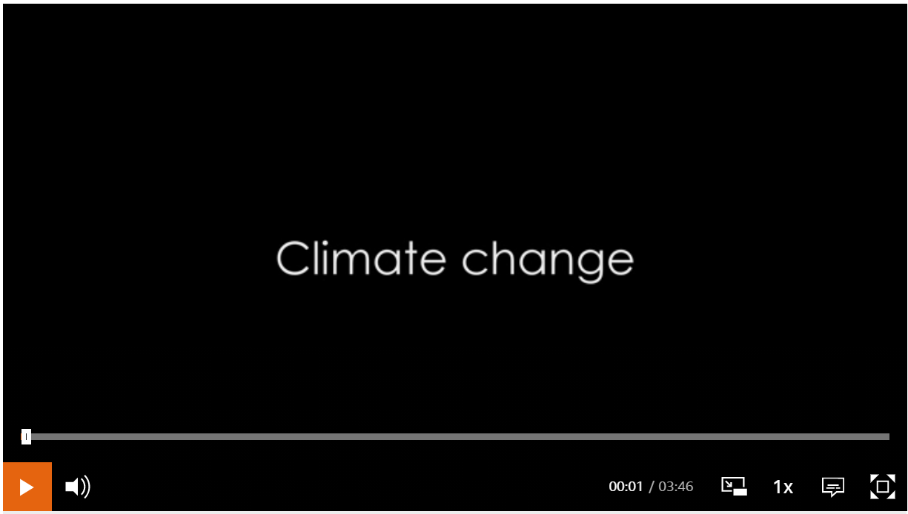
Notes:
Task: Can you write a definition of Climate Change in groups/pairs?
Can we agree on a definition as a class?

Slide 5
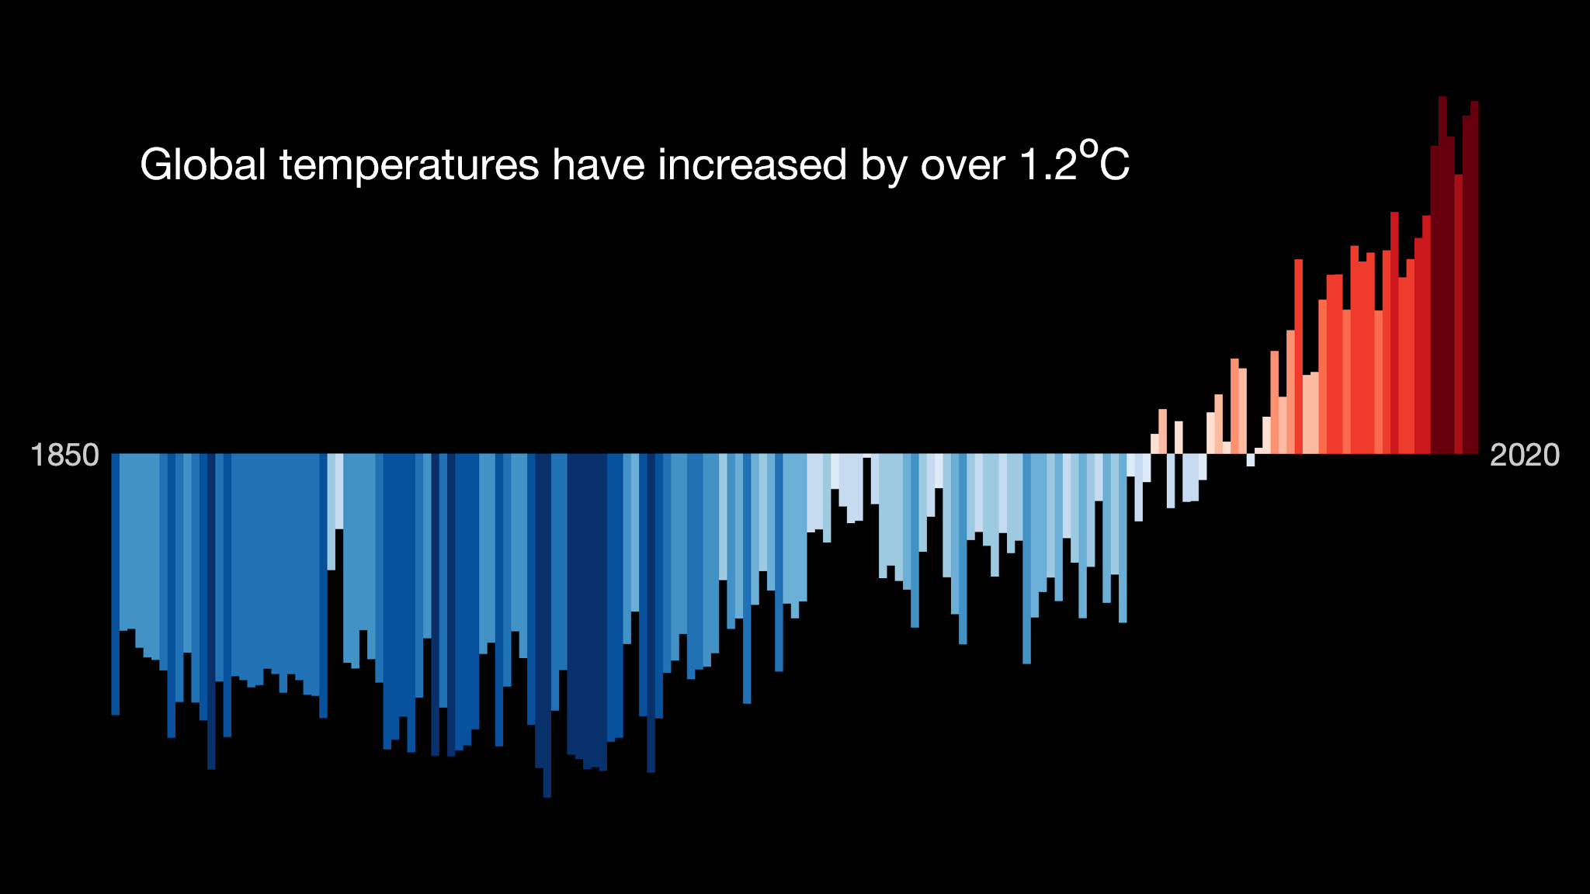
Notes:
Ed Hawkins - Warming Stripes. Shows the temperature variation from a baseline 1990 level from 1850 to the present day. Darker blue is colder and darker red is hotter.

Slide 6
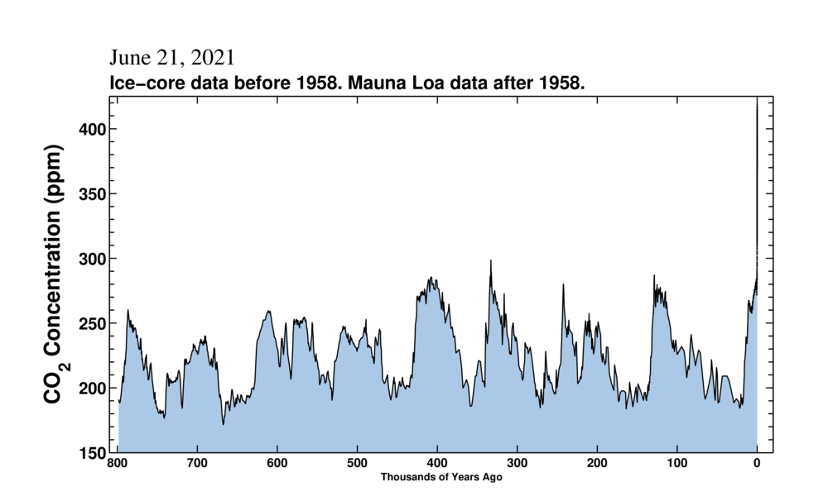
Notes:
Keeling Curve - Showing carbon dioxide concentration over the last 800,000 years which is currently around 420ppm.

Slide 7
Where do our emissions come from?
Create a mind map of where greenhouse gases come from.
Notes:
Using a whiteboard/smartboard/flip chart mind map the different sources of GHG emissions
Hints: Where do we get our energy and electricity? How do we get around? How is all our stuff made? What do we eat?

Slide 8
Where do UK Emissions come from?
Categories:
Agriculture
Buildings
Bunker Fuels
Electricity & Heat
Fuel combustion
Industry
Manufacturing
Transport
Waste
Notes:
Bunker fuel is any fuel used on board a ship

Slide 9
Where do UK Emissions come from?

Slide 10
Where do Transport Emissions come from?
UK Transport Emissions (2019)
Aviation (domestic)
Buses/coaches
Cars/taxis
HGVs
LGVs
Rail
Shipping (domestic)
Other
Notes:
Can you match up the categories?
Domestic aviation/shipping is flights and boat which only go between places in the UK. E.g. a flight from London to Edinburgh, or a ferry from Southampton to the Isle of White.
HGV = heavy goods vehicle
LGV = light goods vehicle

Slide 11
Where do Transport Emissions come from?
Notes:
How many did you get right?

Slide 12
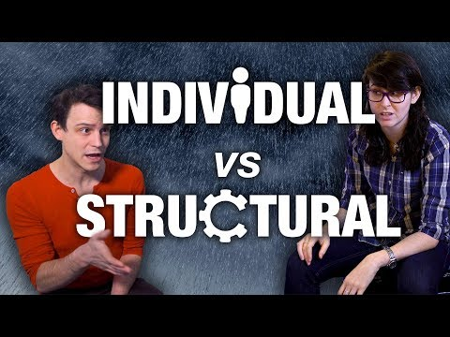
How can we reduce emissions?
Using the mind map you created earlier, think about how we can reduce emissions.
What could we do as individuals?
What do we need to do as a society?
What does the government need to do?
What would make the most impact?
Notes:
Using the mind map created earlier in the session - how could we reduce emissions from each sector?
What could we individually do?
What could we do as a society?
Extension:
What does the government need to do?

Slide 13
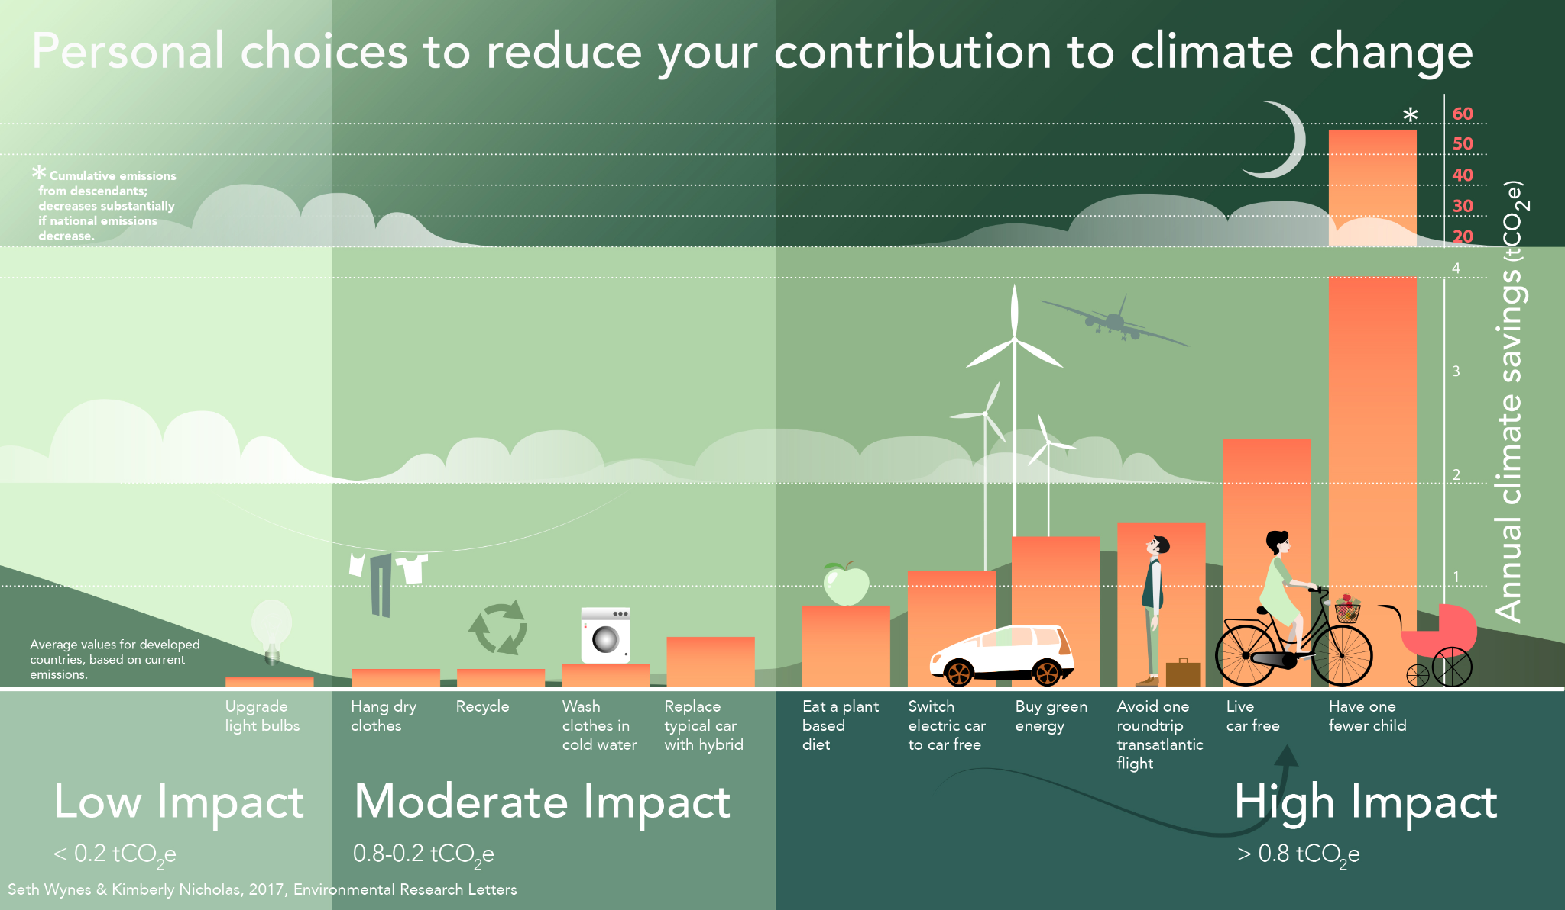
Notes:
In an academic paper published in 2017 analysed all of the things people could do in their own lives to make an impact on climate change.
This graph shows what the researchers found.
Do any of these things surprise you?
Are any less/more important than you thought they would be? (e.g. We are all encouraged to recycle, and we all have recycling bins provided by the council, but this has a much lower impact than buying green energy)
Note: this doesn’t mean that you shouldn’t recycle/wash your clothes on a low temp etc. As Tesco says - every little helps!
Link to paper: https://iopscience.iop.org/article/10.1088/1748-9326/aa7541/meta

Slide 14
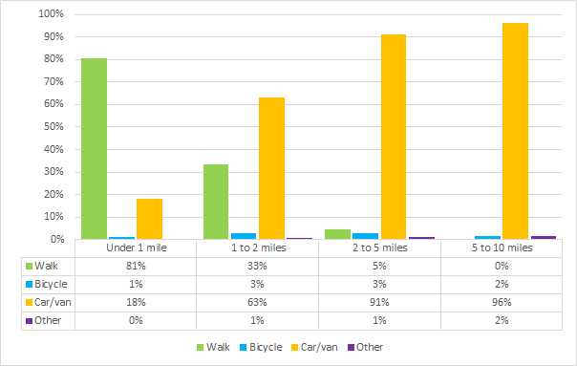
This Machine Fights Climate Change
20% of journeys are under 1 mile (5 minute cycle)
38% of journeys are under 2 miles (10 minute cycle)
66% journeys are under 5 miles (25 minute cycle)
Notes:
Discussion around graph – percentage of journeys taken by different modes. Could we change this?
How far can most people walk/cycle?
Why do people choose to drive?
What are the other benefits of walking and cycling (active travel) over using a private car?

Slide 15
My Carbon Pledge
I commit to…
Come up with a pledge that you can make to reduce your greenhouse gas emissions. Think of a small change, like cycling or walking short journeys.
This could be something you do as an individual, or you could decide on a group or class action.

Slide 16


