Slide 1
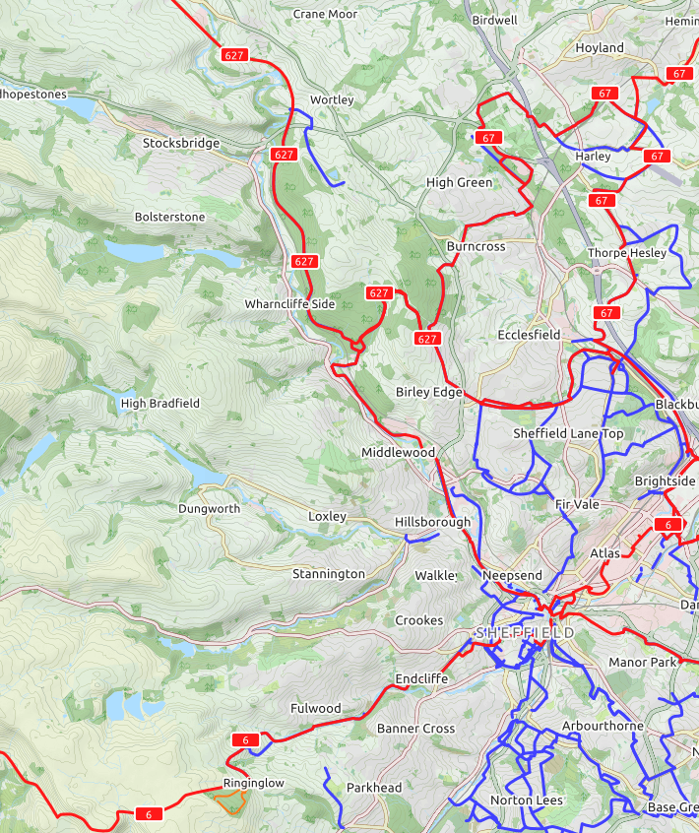

Route planning my cycling journey

Slide 2


Which route planning tool should I use?
Exploring the features of Google Maps and Komoot

Slide 3
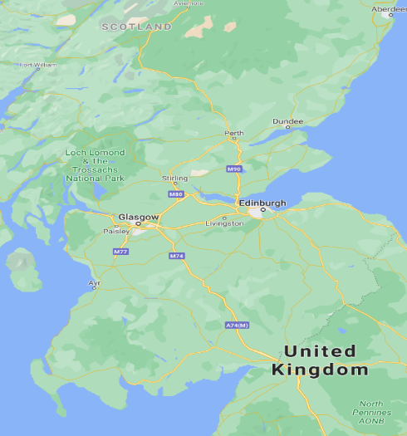
Google Maps
Google Maps is one of the most used online mapping and route mapping tools.
It’s really easy to use, and allows you to quickly plan routes from A to B.
It can also be used for different types of transport, including driving, public transport, walking, and cycling.
Google Maps can be used on a computer, tablet, or phone, and routes can be shared with other devices and people.
Click here to open Google Maps

Slide 4
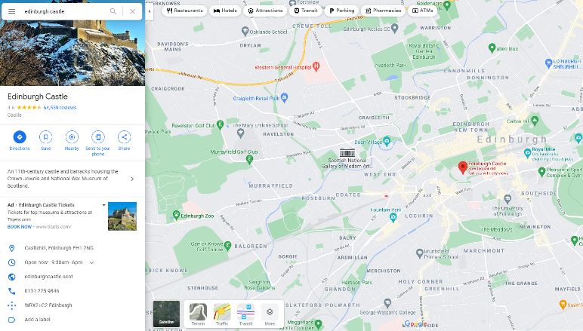
Features of Google Maps
The search box allows you to find a location.
You can use a postcode, an address, or the name of a place.
Google maps shows you places of interest.
These could be shops, parks, or tourist attractions.
This arrow is used to find directions to or from the location you have typed in.
This yellow figure enables you to use street view mode. Click and hold him, and then drag him onto a highlighted street or circle.
When you search for a place, Google Maps will give you lots of interesting information.
You can click this box to switch the map into satellite mode. Hover over the box to see more layers, and click more to see everything.
More on this in the next slide.

Slide 5
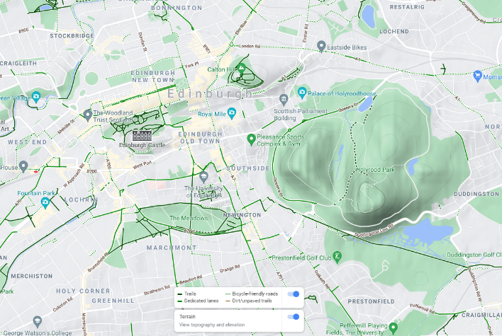
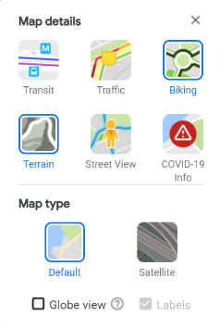
Layers in Google Maps
Terrain
The terrain layer enables you to see contour lines. On this example, you can see the hills in Holyrood Park. When planning a cycling route, you could use this to avoid steep hills.
Biking
The biking layers shows bike lanes. The key is at the bottom of the screen. This is also useful when planning a cycling route.

Slide 6
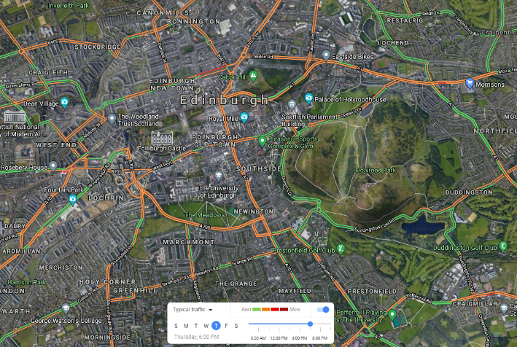
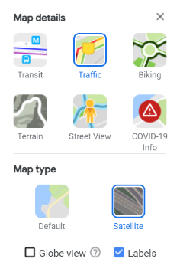
Layers in Google Maps
Traffic
The traffic layer uses colours to show how busy streets are. You can either use live data, or set it to ‘typical traffic’. This example shows traffic on Thursdays at 6pm.
Busy streets indicate that the air quality will be lower, so it’s best to plan routes which avoid these streets.
Satellite
The satellite layer uses satellite imagery.

Slide 7
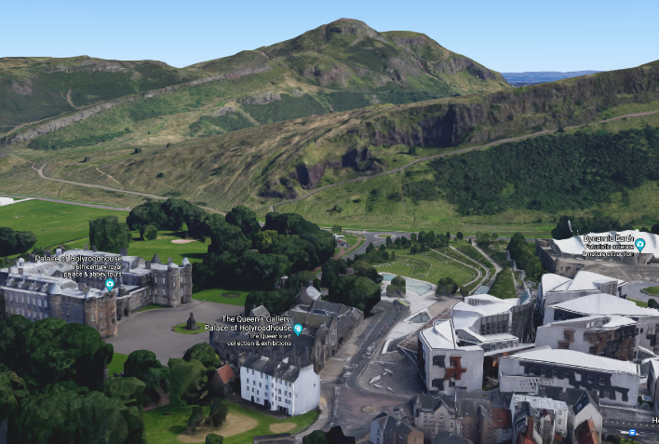
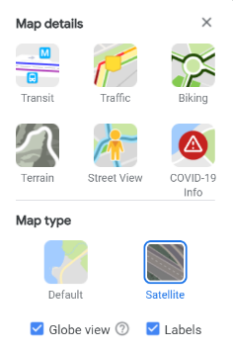
Layers in Google Maps
Globe View (only in satellite)
Globe view enables you to see things in 3D.
Tick the box to turn it on and zoom in. Then hold down the shift key and use your mouse to tilt the view.
In this example, you can see the Scottish Parliament with Holyrood Park rising in the background.

Slide 8
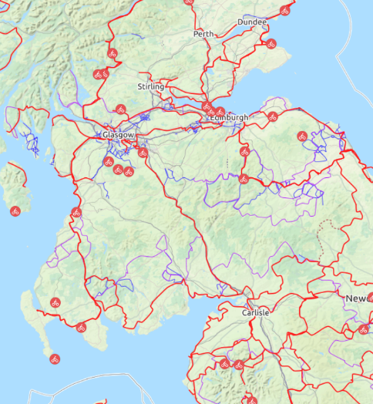
Komoot
Komoot can be used to both plan routes and explore routes other people have made.
It’s specifically designed for active travel, and you can choose which type you want to use.
It offers a range of different map layers, including OpenCycleMap which clearly shows cycle paths.
When you’ve plotted a route, it tells you which surfaces you’ll be riding on.
It can be used on a computer, tablet, or phone.
Click here to open Komoot

Slide 9
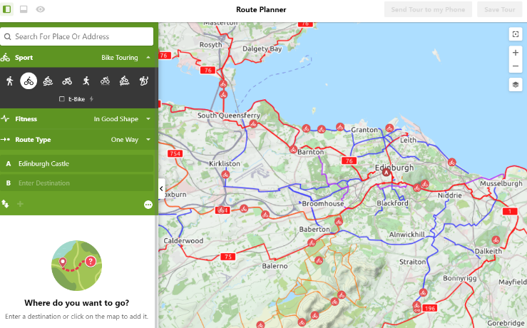
Features of Komoot
The search box allows you to find a location.
You can use a postcode, an address, of the name of a place, such as a school.
This button allows you to change layer.
Komoot is currently showing Open Cycle Maps, as this map shows all the cycle paths.
Here you can choose what type of active travel you are doing. You can also choose how fit you are.
These setting help Komoot choose the most suitable route.
On Open Cycle Maps, the red lines show paths on the National Cycle Network, which is managed by Sustrans.
The purple and blue lines show other cycle paths.
The small red bikes are places which other Komoot users have tagged as interesting, such as good viewpoints or tourist attractions.

Slide 10
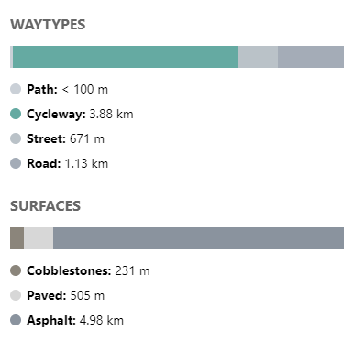

Features of Komoot
Komoot has a useful feature which shows you the type of surface. This is shown both is the left hand panel, and the bottom panel.
If you click on a surface type, it will highlight it on the map.
The bottom panel also shows elevation, with the colours reflecting steepness (green – not too steep, red – very steep).
When planning a route, you probably want to avoid steep hills and rough terrain, unless you have a mountain bike.
Notes:
https://www.opencyclemap.org/docs/

Slide 11
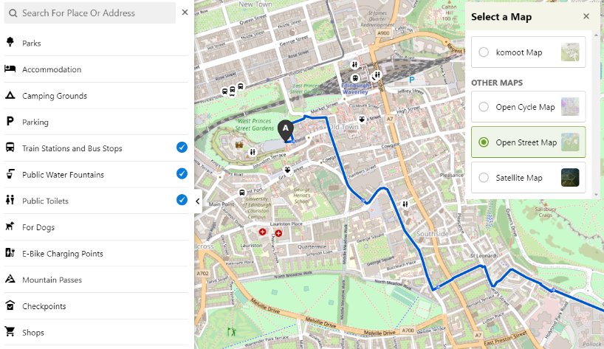
Layers in Komoot
Open Street Map shows lots of places of interest, such as public buildings and tourist attractions.
You can also add more features using Komoot.
Once you’ve planned a route, if you click in the search bar you can choose to highlight other places of interest.
Here bus stops and train stations, water fountains, and toilets have been added.
Notes:
https://www.opencyclemap.org/docs/

Slide 12
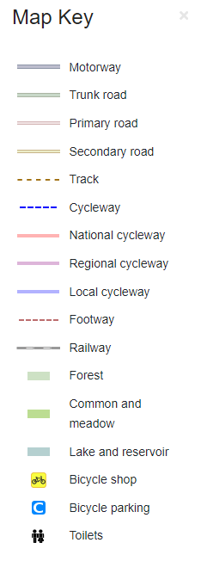
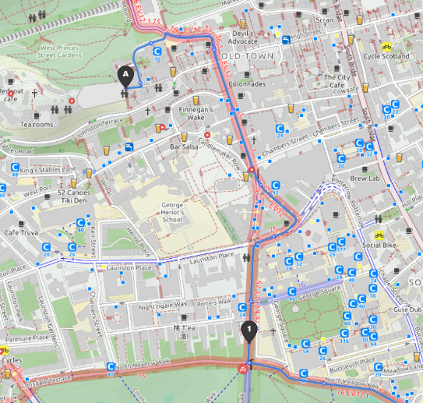
Layers in Komoot
Open Cycle Map shows lots of useful destinations for cyclists.
These include bike parking, bike shops, and cycleways.
This route from Edinburgh Castle travels along a number of national cycleways. The numbers on the cycleways show which route they are.
This route travels along the number 1, 75 and 76 (on the national cycle network), as well as the EV12 (a EuroVelo route around the North Sea).
Notes:
https://www.opencyclemap.org/docs/

Slide 13
How to plan a route
Using Google Maps and Komoot
Document title | 12 July 2021

Slide 14
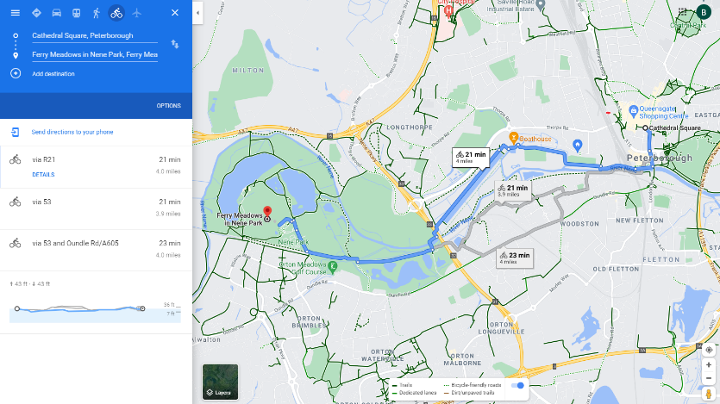
EXAMPLE 1
Planning a route using Google Maps
This route is for cycling
The route goes between a country park where you can hire bikes, and Peterborough Cathedral.
Click here to go to the route
These boxes show how long each route is. If you click them the route will change.
Click the plus to add another destination. Try adding Ailsworth, a nearby village.
You can drag the route if you want to amend it. Try playing around with it.
Google has come up with three different routes. You can see the distance of each. To change to kilometres, click options.
They are also shown on the map.
It also shows the elevation profile – the hills along the route
The biking layer has been turned on, and now you can see bike paths in dark green on the map.

Slide 15
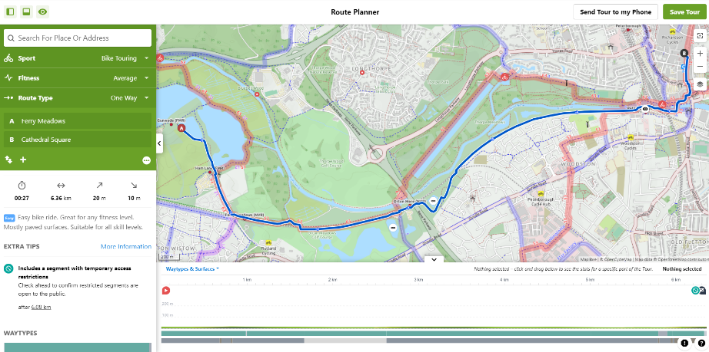
EXAMPLE 2
Planning a route using Komoot
The middle button turns on and off the elevation profile.
This route is for bike touring.
The layer has been changed to Open Cycle Maps.
You see the cycle routes marked on the map.
This route also goes from the park to the Cathedral.
Do you notice any differences?
Click here to go to the route
Here you can see how far the route it and how long it will take. You can also see how much it goes up and down.
You can drag the route if you want to amend it. Try playing around with it.
Komoot gives other useful information, including how hard it thinks the route is, and any extra tips.
Here you can see the elevation profile. Peterborough is very flat, so there aren’t any hills.
These two lines along the bottom show the type of paths. Hover over them to see what they say.

Slide 16


YOUR TURN!
Plan your own route
Try using both Google Maps and Komoot, and see which one you prefer Click the icons above to go to the websites.
Choose where you want your route to start and end. You could go somewhere from school, or choose two interesting places within your local area to go between.
Think about how you can use the features in each resource to make the route as nice to cycle as possible. For example, try to use cycle paths instead of roads, and avoid steep hills.
You can look back through the slides if you can’t remember how to do everything.
Fill in your worksheet as you go.

