Slide 1
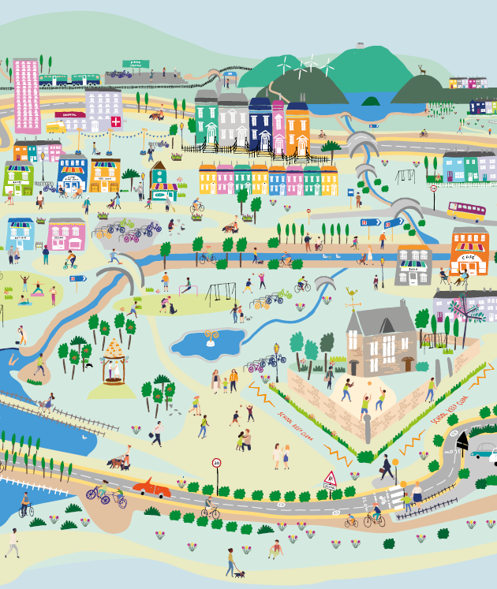
Session 1a: Engage
Places that are good for the planet and for people
Creating 20 minute neighbourhoods

Slide 2
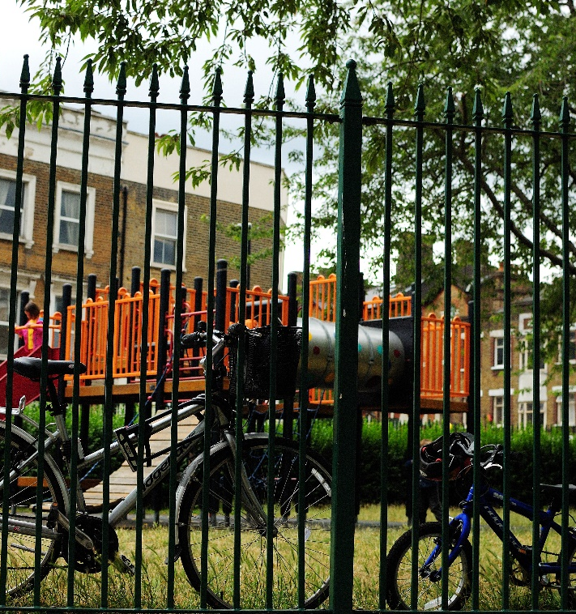
Overview
Engage
Climate change and COP – what are they are how do they link?
What is Scotland doing to tackle Climate Change?
How could our local neighbourhood become a place that is good for both the planet and for people?
What are 20 minute neighbourhoods?
Explore: Go out into our local neighbourhood.
Evaluate: How does out local neighbourhood measure up?
Create: How would we design our local neighbourhood?
Notes:
This is the first of four workshops, through which pupils will develop an understanding of why changing how we live can help tackle climate change, and learn about 20 minute neighbourhoods.
The four sessions are outlined in the slide:
Engage – learn about COP26, how we can create places that are good for the planet and for people
Explore – go out and explore your own 20 minute neighbourhood
Evaluate – think about how well your neighbourhood measures up; what was good and what could be better
Create – design a vision of a 20 minute neighbourhood
Overview of this session
What is COP26, and why is it important?
Who are Sustrans, and what are we doing about climate change and COP?
Government transport targets?
How could the places we live be changed to help make both the planet and people healthier? What is a 20 minute neighbourhood?
Prepare for the next session – work out where we want to explore in our 20 minute neighbourhood.

Slide 3
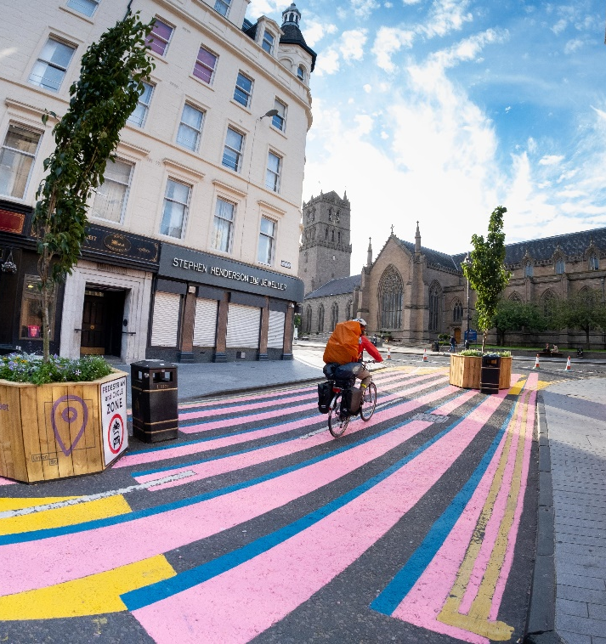
Sustrans
These workshops have been designed by Sustrans, a walking and cycling charity.
Their vision is a society where the way we travel creates healthier places and happier lives for everyone.
They are concerned about climate change, as transport emits lots of greenhouse gases.
Most emissions from transport are caused by people driving their cars.
Notes:
These workshops have been designed by Sustrans, a British walking and cycling charity.
Their vision is a society where the way we travel creates healthier places and happier lives for everyone.
Their mission is to make it easier for people to walk and cycle.
They are concerned about climate change, as transport emits lot of greenhouse gases.

Slide 4

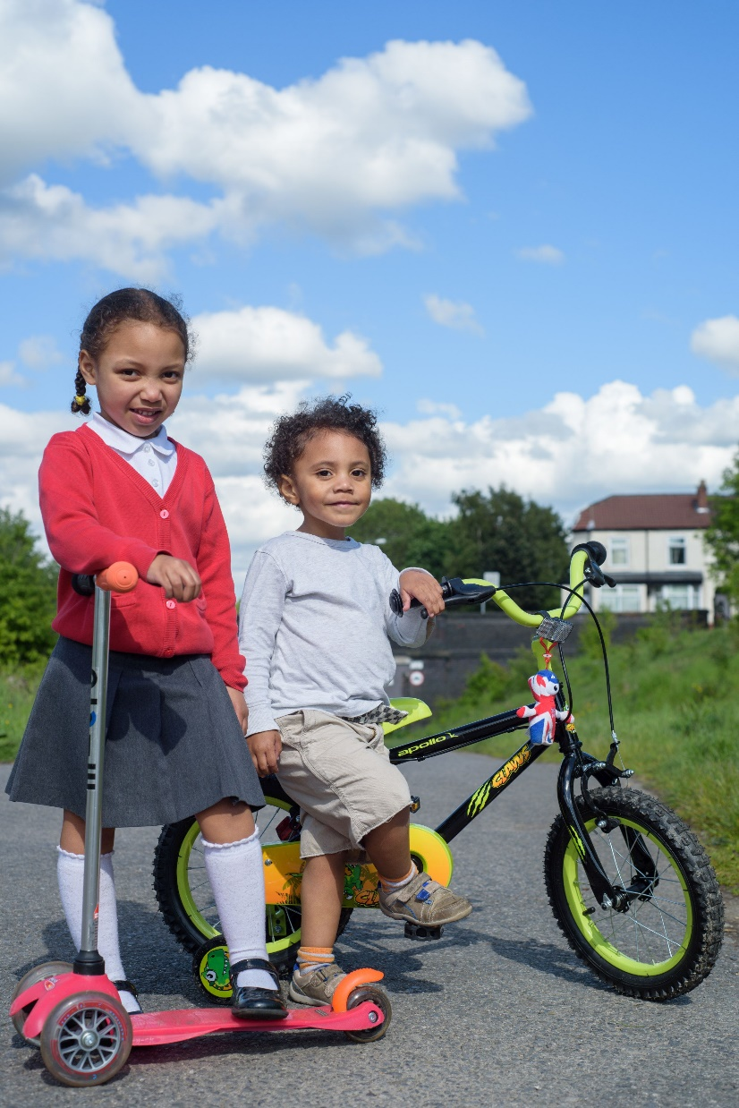

Climate Change
& COP26
What is Climate Change, and what is COP26 trying to do about it?

Slide 5

What is Climate Change?
Definition: Change happening to our global climate over a long period of time
What’s the difference between weather and climate?
Global temperatures have been rising for over 100 years, and are now the highest on record.
This is changing our weather which impacts people, animals and plants around the world.
Notes:
Q: What is climate change? Can anyone give me a definition?
Climate change is change that happens to our global climate over a long period of time.
Weather is something that happens day to day – today it might be warm and sunny, but tomorrow could be cold and rainy.
Climate is the average kind of weather places get. In Scotland, our climate could be described as ‘temperate’ – it doesn’t tend to get too cold or too hot, and we don’t usually get droughts or big floods.
Global temperatures have been rising for over a century and accelerating over the past 30 years, with temperatures now the highest on record.
This is affecting weather patterns which impacts people, animals, and plants. People and wildlife often can’t keep up with the changes that are happening to their homes.

Slide 6
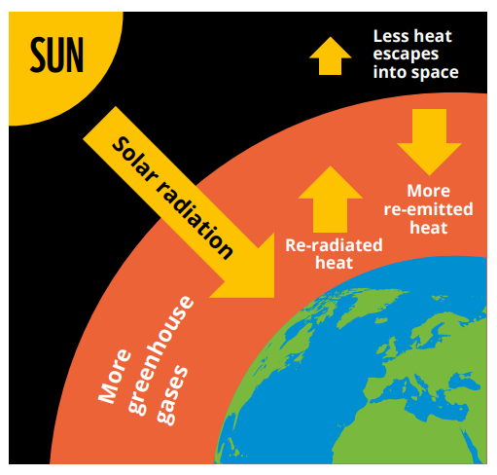
What causes Climate Change?
Modern Climate Change is caused by people.
Human activity is releasing greenhouse gases into the atmosphere.
These gases include carbon dioxide, methane, and CFCs.
These emissions are causing the planet to warm up by trapping the sun’s heat.
Where do these greenhouse gases come from?
Notes:
What causes Climate Change?
Modern climate change is caused by human activity, which is releasing greenhouse gases into the atmosphere.
These gases are carbon dioxide, surface level ozone, water vapour, methane, nitrous gases, and CFCs (Chlorofluorocarbons).
The biggest contributor to the warming effect is carbon dioxide, which is released by burning fossil fuels for energy, farming, and destroying forests.
These emissions are causing the greenhouse effect – trapping heat and making the Earth warmer to an extent that can’t be explained by natural factors alone.
In the past (millions of years) the climate has changed due to natural forces, such as volcanic eruption or fluctuation in the sun’s activity. However, the difference now is that the amount of greenhouse gases in the atmosphere is much higher than ever recorded, and is still rapidly rising due to human emissions.

Slide 7
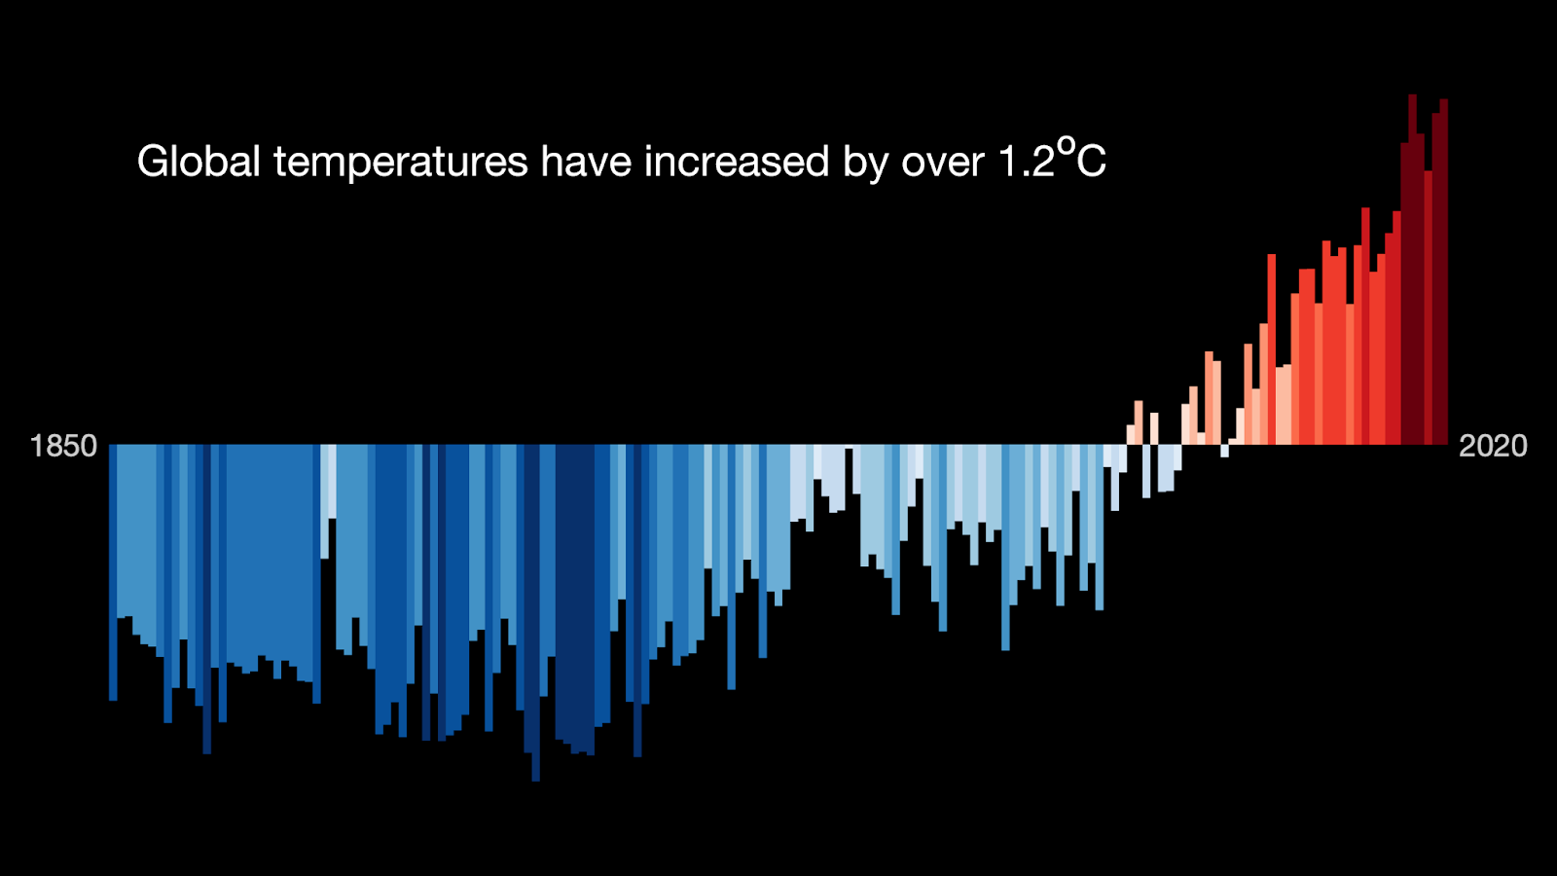
What happens when our climate changes?
Climate change has caused our global temperature to rise by over 1⁰C since 1900.
According to scientists, we need to keep our global temperature rise under 1.5⁰C.

Slide 8
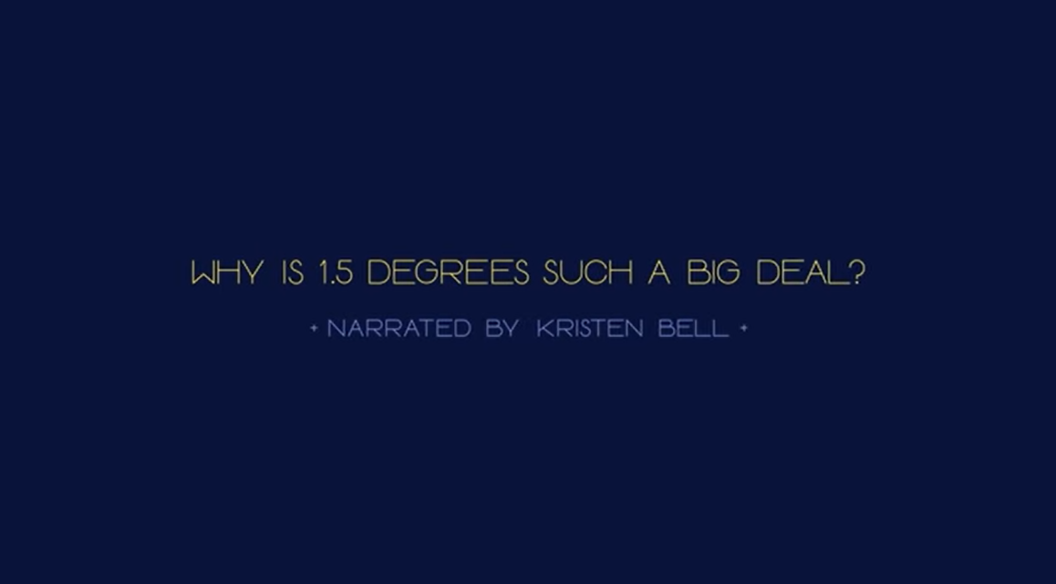

Why is 1.5 degrees important?

Slide 9

What are the impacts of Climate Change?
In groups, create a mind map showing the impacts of climate change.
Start by thinking about the changes that are happening to the earth.
E.g. More extreme weather events like floods
Then think about how these changes could impact people and animals.
E.g. People and animals could lose their homes due to flooding.
Notes:
In group/pairs (or as a class) make a mind map of the impacts of climate change
Changes to the ocean – ocean acidification, warming ocean temperatures – coral bleaching, loss of fish species – people who eat lots of fish will struggle to find food
Melting of ice caps/sheets/glaciers – sea level rise, changing of water cycle – low lying nations and areas will be flooded, people who rely on meltwater for drinking water will be impacted, animals will lose their habitats
More extreme weather events (hurricanes, flood, drought etc.) – people and animals will struggle to deal with more extreme conditions
Changing weather patterns – seasons and average temperatures will change – habitats will be destroyed (vegetation and animals are not adapted and will die/migrate) – people will have to adjust their lives, agriculture and food supply will be impacted
Warmer temperatures – species will migrate – disease carrying species may travel further north e.g. mosquitos

Slide 10
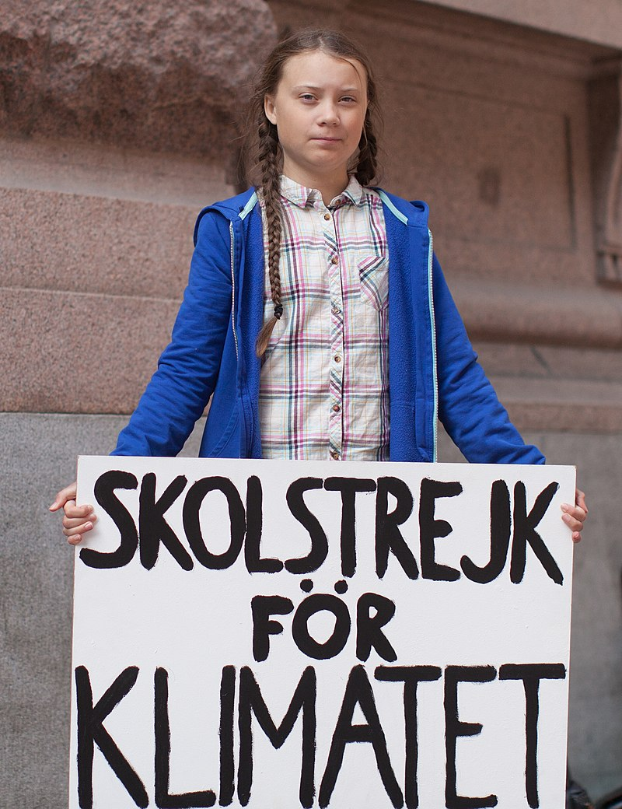
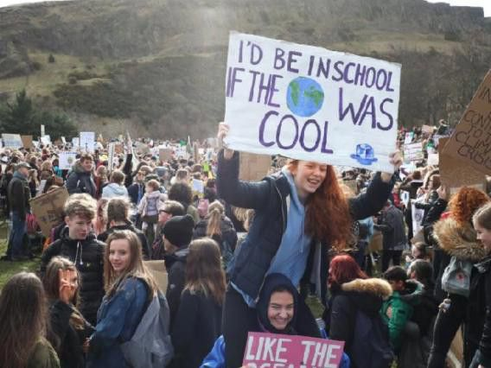
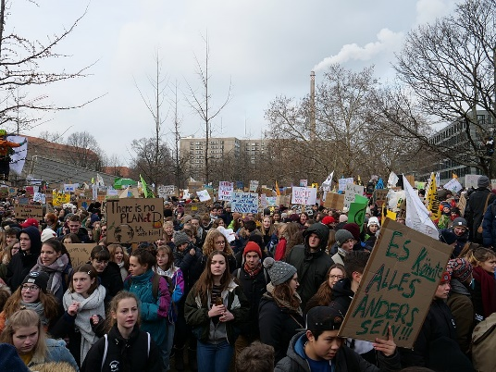
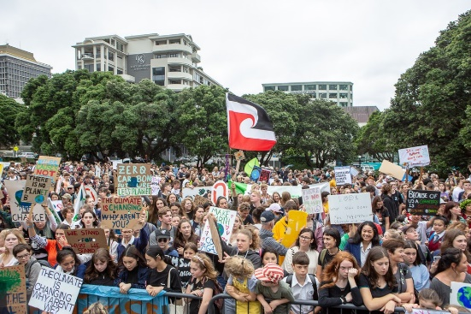
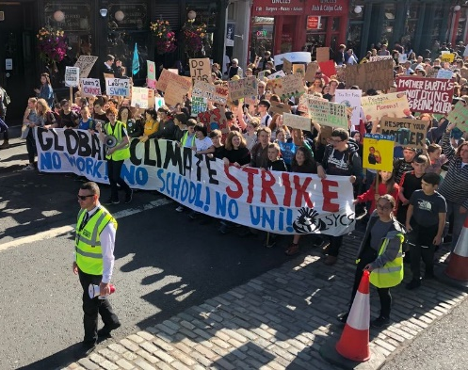
What are young people doing?
Notes:
Discussion around the school strikes.
Why were young people striking? Did any of you strike? Why/why not? What are they trying to achieve?

Slide 11
What is COP26?
Notes:
What is COP26?
Ask the class what they already know.
Q: Does anyone know anything about COP26 already?

Slide 12

What is COP26?
COP26 (Conference Of the Parties) is a United Nations Climate Change Conference.
It’s a global event where leaders from countries across the world come together to discuss how they’re going to tackle Climate Change.
It will be held in Glasgow from 1-12 November.
Aim: To stabilise greenhouse gas concentrations at a level that will stop dangerous human-caused climate change.
Simply put, we must keep temperature rise under 1.5°C.
Notes:
COP26 is a United Nations Climate Change Conference. It’s a global summit where leaders from countries around the world come together to discuss how they are going to tackle climate change.
COP stands for Conference of the Parties, and will be attended by counties that signed the United Nations Framework Convention on Climate Change (UNFCCC) – a treaty agreed in 1994. The 2021 meeting will be the 26th meeting, which is why it’s called COP26. It will be held between 1-12 November 2021.
Objective: to stabilise greenhouse gas concentrations in the atmosphere at a level that would stop dangerous human-caused changes to the climate.

Slide 13
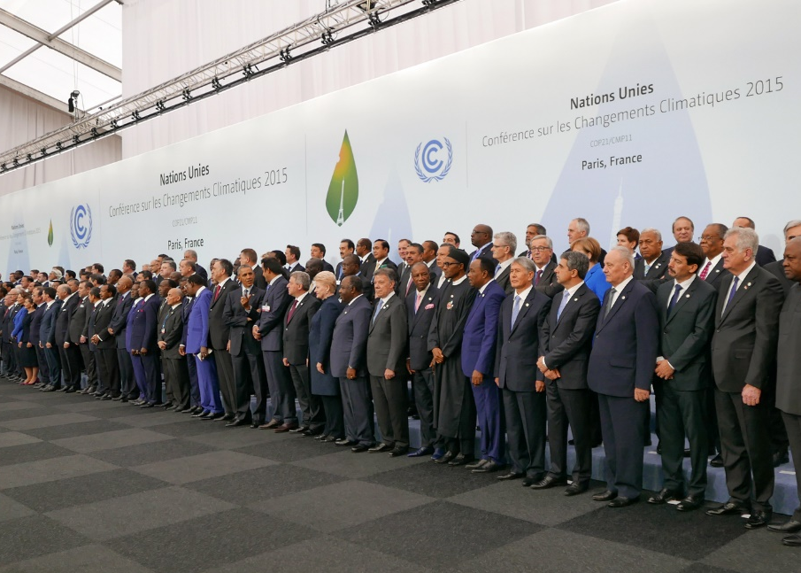
What will happen at COP26?
The focus of COP26 will be discussing the Paris Agreement, which was signed by 196 countries in 2015.
This agreement says that countries must:
Reduce their greenhouse gas production
Keep global temperature rise below 2°C
Review progress every 5 years
Spend $100 billion to help poorer countries.
World leaders at COP21 in Paris
Notes:
The main topic of this year’s COP will be discussing the Paris Agreement, the agreement that 196 countries signed at COP21 in 2015.
The Paris Agreement says that nations must:
Reduce the amount of harmful greenhouse gases produced and increase renewable energy types
Keep global temperature increase below 2°C, and try to limit it to 1.5°C.
Review progress every five years
Spend $100 billion a year in climate finance to help poorer countries by 2020
But why are greenhouse gases and climate change important?

Slide 14
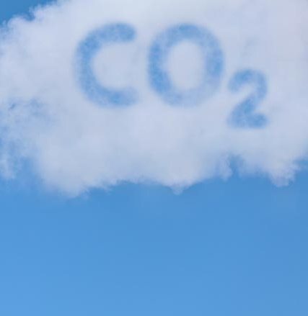
Where do our emissions come from?

Slide 15
Where do UK Emissions come from?
UK Emissions (2019)
Agriculture
Buildings
Bunker Fuels
Electricity & Heat
Fuel Combustion
Industry
Manufacturing
Transport
Waste
Notes:
Can you match up the categories?
Bunker fuels are fuels use by ships.

Slide 16
Where do UK Emissions come from?
Notes:
How many did you get right? Did any surprise you?

Slide 17
Where do Transport Emissions come from?
UK Transport Emissions (2019)
Aviation (domestic)
Buses/coaches
Cars/taxis
HGVs
LGVs
Rail
Shipping (domestic)
Other
Notes:
Can you match up the categories?
Domestic aviation/shipping is flights and boat which only go between places in the UK. E.g. a flight from London to Edinburgh, or a ferry from Southampton to the Isle of Wight.
HGV = heavy goods vehicle
LGV = light goods vehicle

Slide 18
Where do Transport Emissions come from?
Notes:
How many did you get right?

Slide 19
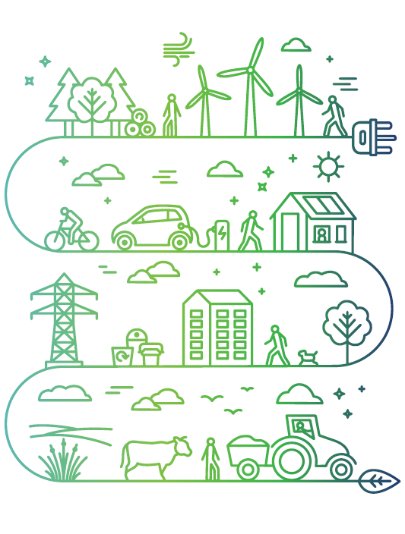
What is Scotland doing?
Scotland’s Climate Change plan

Slide 20
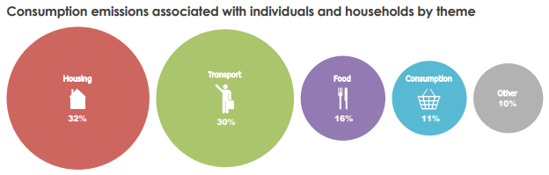
Scotland’s Climate Change Plan
The Scottish Government is aiming to reach net zero by 2045.
There are 7 key areas it is focussing on:
Electricity
Buildings
Transport
Industry
Waste
Land Use
Agriculture
Individual and household emissions by type
Notes:
The Scottish Government has committed to reduce emissions by 75% by 2030 (compared with 1990), and to net zero by 2045.
Q: What does net zero mean?
Talk about individual emissions

Slide 21
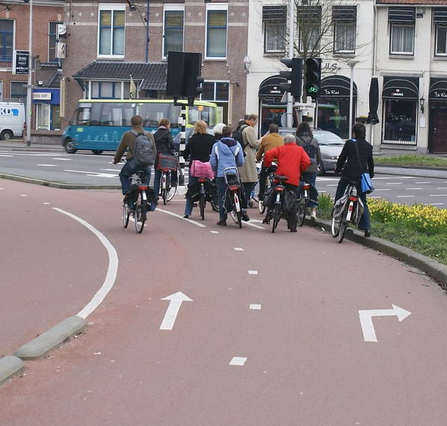
What does this mean for Transport?
No more petrol or diesel vehicles for sale by 2030. Instead, electric vehicles will be available.
By 2030 walking and cycling will be the most popular choice for everyday journeys.
Scotland will need more cycle paths, hire bikes, electric bikes, and cargo bikes.
More places will be made into 20 minute neighbourhoods.
Notes:
What does this mean for transport?
By 2030 there will be no more petrol or diesel cars for sale in the UK. Instead, people will only be able to buy electric vehicles.
Q: Are electric vehicles a solution?
Think about a busy street, and then imagine what it would look like if everyone owned electric cars instead.
They aren’t a solution on their own – although they reduce emissions, they still cause congestion.
By 2030 walking and cycling will need to be the most popular choice for everyday journeys. Scotland will need to invest in more cycle paths, to make sure that people can safely get where they need to go, and there will be more hire bikes, electric bikes, and cargo bikes.
Scotland will also be introducing more 20 minute neighbourhoods.

Slide 22

What could I do?
Come up with an action you could take to reduce your impact on the environment.
My personal climate pledge is to…

