Slide 1
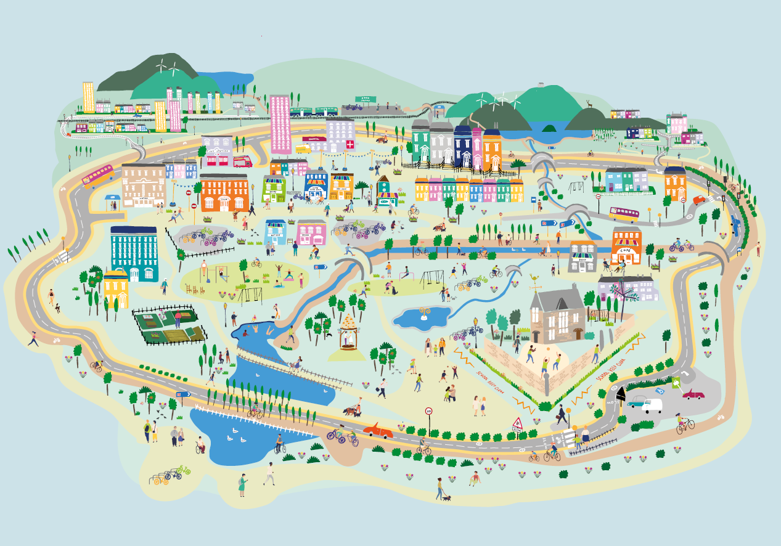
Session 1b: Engage
Places that are good for the planet and for people
Creating 20 minute neighbourhoods

Slide 2
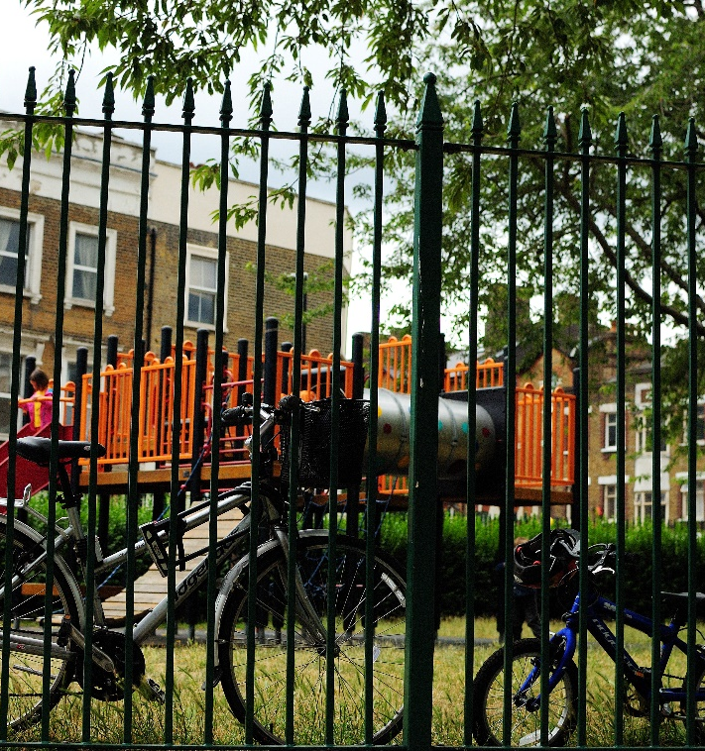
Overview
Engage
Climate change and COP – what are they are how do they link?
What is Scotland doing to tackle Climate Change?
How could our local neighbourhood become a place that is good for both the planet and for people?
What are 20 minute neighbourhoods?
Explore: Go out into our local neighbourhood.
Evaluate: How does out local neighbourhood measure up?
Create: How would we design our local neighbourhood?
Notes:
This is the first of four workshops, through which pupils will develop an understanding of why changing how we live can help tackle Climate Change, and learn about 20 minute neighbourhoods.
The four sessions are outlined in the slide:
Engage – learn about COP26, how we can create places that are good for the planet and for people
Explore – go out and explore your own 20 minute neighbourhood
Evaluate – think about how well your neighbourhood measures up; what was good and what could be better
Create – design a vision of a 20 minute neighbourhood
Overview of this session
What is COP26, and why is it important?
Who are Sustrans, and what are we doing about Climate Change and COP?
Government transport targets?
How could the places we live be changed to help make both the planet and people healthier? What is a 20 minute neighbourhood?
Prepare for the next session – work out where we want to explore in our 20 minute neighbourhood.

Slide 3

Recap from last session
What is Climate Change?
What causes Climate Change?
What are the impacts of Climate Change?
What is COP26? What is it trying to achieve?
In the UK, where do most of our emissions come from?
What about our transport emissions?
What is Scotland doing about Climate Change?
Notes:
Climate change – change happening to our global climate over a long time period.
Climate change is caused by humans. In the last 50+ years we have released too many greenhouse gases (including carbon dioxide) into the air. These gases trap the sun’s heat, causing warming and messing up our planetary systems. This is leading to more dramatic weather patterns and events (such as the recent fires in America, Australia, and Greece, and flooding in the UK and in Europe), as well as sea level rise as the ice sheets melt, and ocean acidification as more carbon dioxide is absorbed by our seas.
There are many impacts associated with climate change – changes to weather patterns, the oceans, the land, destruction of habitats, warmer temperatures, more extreme weather events, species will go extinct as their habitats change, humans will be under pressure, it may be more difficult to grow food, weather events will destroy homes, there will be more drought and fires.
In the UK, most of our emissions come from electricity and heat, closely followed by transport. Between them they almost make up half of the UK’s emissions.
In transport, 55% of emissions come from cars.
Scotland has a climate change strategy which includes cutting out petrol and diesel cars by 2030 and building more bike lanes and footpaths.

Slide 4
20 minute neighbourhoods
What are 20 minute neighbourhoods?
How can they help create places that are good for people and for the planet?

Slide 5
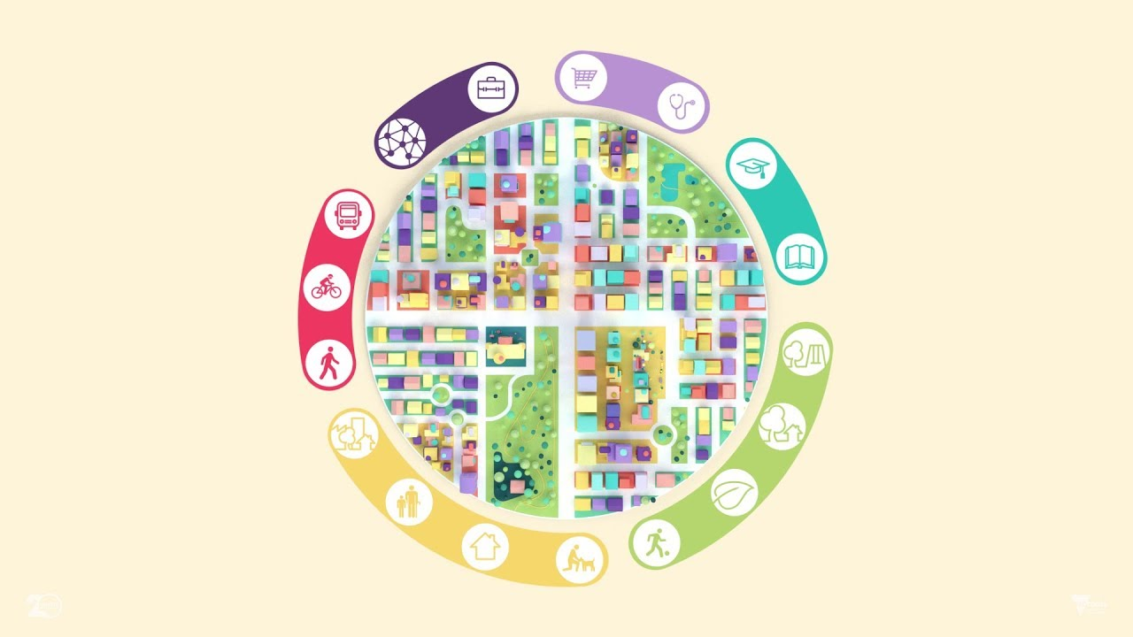

What is a 20 minute neighbourhood?
Notes:
The 20 minute neighbourhood is an idea that is becoming popular across the world.
Developed in different ways in cities like Melbourne, Portland and Paris, people can meet most of their essential needs within a 20 minute walk.
This means you can do your shopping, join in with leisure activities, take your children to school, find local services like your GP practice and ideally get to work – all within easy access of where you live.
It also means having greenspace on your doorstep and a local environment that encourages active travel to promote health and well‑being.
It is a place where people want to live, so affordable housing must be part of it.

Slide 6
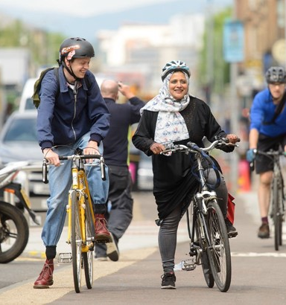

What is a 20 minute neighbourhood?
Sustrans wants to see places that connect us to each other and to what we need, where we can thrive without using a car.
They want liveable cities and towns for everyone.
They think the best way to do this is to ensure that it is easy for people to get to most places by a short 20 minute return walk.
10 minutes there, 10 minutes back.
What do we need to make this happen?
Notes:
At Sustrans, our goal for cities and towns is for them to be places that connect us to each other and what we need, where we can thrive without using a car.
We want liveable cities and towns for everyone.
We think that the best way to do this is to ensure that it is easy for people to meet most of their everyday needs by a short 20 minute return walk.
10 minutes there, 10 minutes back.
Why 20 minutes? Almost everyone can walk for 10 minutes in each direction. On average, this means that everything should be within an 800m (half a mile) walk.

Slide 7


Components of a 20 min neighbourhood
Places of work/learning
Places we need to go to
20 minute neighbourhood
Places we live
Places we want to go to
How we get there
Notes:
Mindmap in groups
Can use with or without hints/categories
Ask questions about where they need to go at least once a month, then get them to consider the needs of others.
For example they go to school, the park, to the supermarket, the cinema, whereas their parents might go to work, to the shops, to the doctors, to the train station etc.

Slide 8
Components of a 20 min neighbourhood
Work / Learning
Education
Nurseries
Primary Schools
High Schools
Employment
Offices
Other places where people can work
Libraries
Places we need
Health
Doctors
Dentists
Pharmacy
Food
Shops
Places to eat
Money
Banks
Post Offices
Places we want
Entertainment
Cinema/theatre
Community halls
Religious spaces
Sport
Sport fields
Swimming pools
Outside
Public parks
Playgrounds
Hang-out spaces
Places to live
Houses
Well maintained
Different types
  Flats
  Houses
  Care homes
Streets
Clean and tidy
Trees and plants
Feeling safe
How we get there
Public Transport
Buses, trams, trains
Active Transport
Cycle lanes
Footpaths and pavements
Safe crossings
Cars
Slow speeds
Reduced traffic

Slide 9
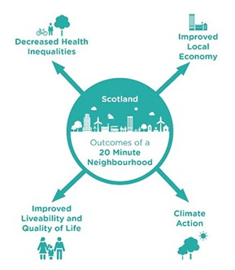

20 minute neighbourhoods in Scotland
The Scottish Government has said that they:
“support the idea of 20 minute neighbourhoods – where people can meet their needs within a 20 minute walk from their house – enabling people to live better, healthier lives and supporting our net zero ambitions”
Can you think of any other benefits of 20 minute neighbourhoods?
Notes:
In the Programme for Government 2020, the Scottish Government said they support the idea of 20 minute neighbourhoods – where people can meet their needs within a 20 minute walk from their house – enabling people to live better, healthier lives and supporting our net zero ambitions.
They will work with local governments across Scotland to make this happen.
Q: Would you like to live in a 20 minute neighbourhood?
How would you and other people benefit?

Slide 10
Route Planning
Where do we want to go?

Slide 11
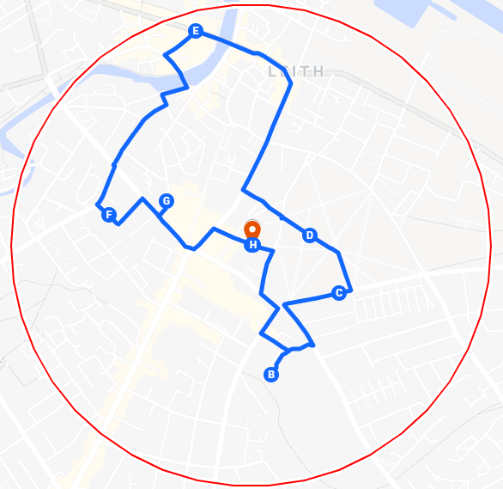
Your 20 Minute Neighbourhood
Using your map, work out a walking route to take you round your 20 minute neighbourhood.
Think about the different things you want to find in your neighbourhood. See the next slide for a detailed breakdown.
Places of work/education
Places we need
Places we want
Where we live
How we get there
Notes:
Plan the route as a class using Google maps, and making sure you stay within the boundary shown on the map provided by Sustrans.
Encourage the class to identify places in the neighbourhood they could walk through – perhaps a park, a shopping street etc.
(Unfortunately there’s no easy way to create a circle on google maps)
The map and instructions can then be printed to be used when outside.
When creating the route, consider the different elements of a 20 minute neighbourhood and try and plan the route around them, to showcase either what is or isn’t present in your neighbourhood.

Slide 12
Your 20 Minute Neighbourhood
Work / Learning
Education
Nurseries
Primary Schools
High Schools
Employment
Offices
Other places where people can work
Places we need
Health
Doctors
Dentists
Pharmacy
Food
Shops and supermarkets
Money
Banks
Post Offices
Places we want
Entertainment
Cinema/theatre
Community halls
Religious spaces
Sport
Sport fields
Swimming pools
Outside
Public parks
Playgrounds
How we get there
Public Transport
Buses, trams, trains
Active Transport
Cycle lanes
Footpaths and pavements
Cars
Slow speeds
Reduced traffic
Places to live
Houses
Different types
  Individuals
  Families
  Older people
Affordable
Streets
Clean and tidy
Trees and plants
Feeling safe
Notes:
It may be best to divide the class into groups to focus on different areas.

